Slide 1
MEMA 101 DAY, MONTH 00, 2018 – CLASSROOM XXX
PREPARING FOR TOMORROW’S DISASTERS TODAY

Slide 2
MEMA 101
Unit 1:
INTRODUCTION

Slide 3
Course Administration
Course/Site Logistics
Emergency Procedures
Schedules
Breaks and lunch
Restrooms
Special accommodations
Cell phones & other electronic devices

Slide 4
Introductions
Name
Job/Position
Years of Experience
Goals/expectations for this course

Slide 5
Course Goal
Upon completion of this course you will be able to:
Describe MEMA’s organization and capabilities.
Understand the National Incident Management System (NIMS), Incident Command System (ICS)
Brief overview of Emergency Management Law, the Stafford Act, HSPD-5, PPD-8 and EMPG.
Identify MEMA’s situational awareness products and tools.

Slide 6
Course Agenda
Unit 1: Introduction
Unit 2: MEMA’s Organizational Structure
Unit 3: National Incident Management System (NIMS)
Unit 4: Mississippi Management Law
Unit 5: Situational Awareness Resource and Tools
Unit 6: Course Summary

Slide 7
MEMA 101
Unit 2:
MEMA’S
ORGANIZATIONAL
STRUCTURE

Slide 8
MEMA’s Organizational Structure

Slide 9
Unit 2 Objectives
At the end of this unit, you will be able to:
Understand MEMA’s mission and organizational structure.
Explain the different offices and their functions, capabilities and services provided.

Slide 10
MISSION STATEMENT
“To coordinate activities that will save lives, protect property and reduce suffering of Mississippi citizens and their communities impacted by disasters through a comprehensive and integrated program of disaster preparedness, response, recovery and mitigation initiatives.”

Slide 11
MEMA’s Offices
MEMA is led by the Executive Director, and organized into seven offices:
Office of Preparedness
Office of Radiological Emergency Preparedness
Office of Response
Office of Recovery
Office of Mitigation
Office of Outreach Services
Office of Support Services

Slide 12
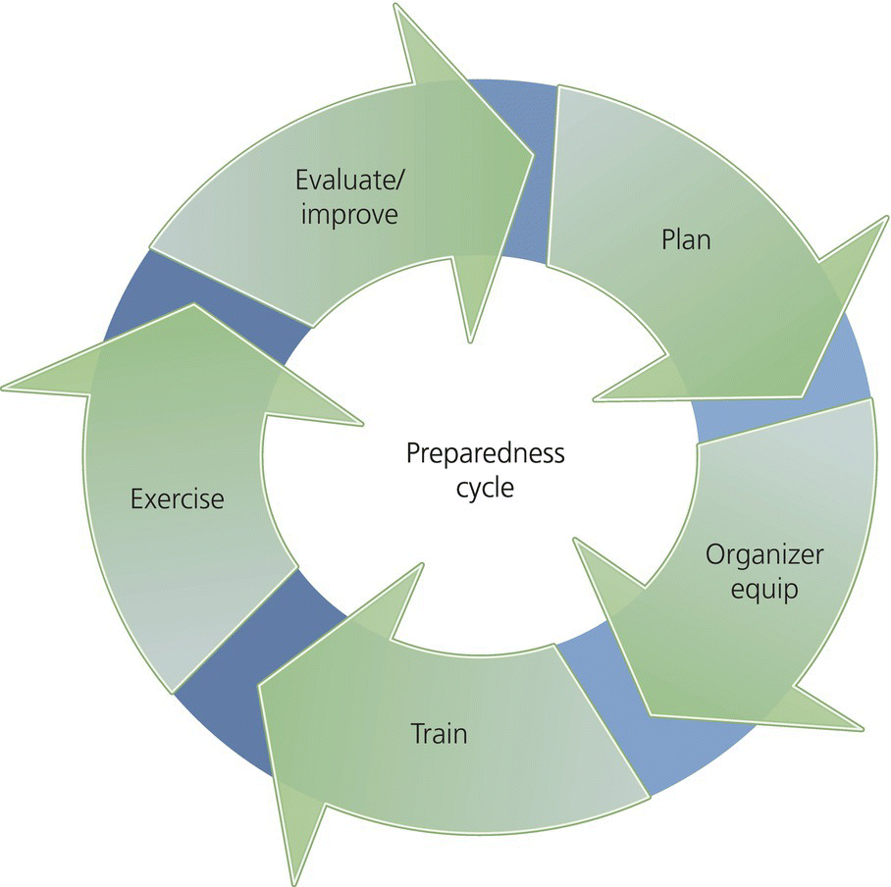
Office of Preparedness
OFFICE OF PREPAREDNESS
Daily oversight for Plans, Training and Exercise Bureaus.

Slide 13
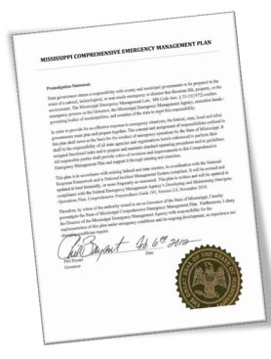
Plans Bureau
Responsible for preparing a State Comprehensive Emergency Management Plan (CEMP) in accordance with state and federal guidelines.
A complete CEMP shall be submitted to the Governor no later than January 1 of every even-numbered year.

Slide 14
Plans Bureau
Responsible for updating and maintaining the following plans, procedures and programs:
MEMA Continuity of Operations Plan (COOP)
MEMA Comprehensive Hurricane Preparedness Plan.
MEMA New Madrid Seismic Zone (NMSZ) Operational Plan.
Implementing activities allowed under the National Earthquake Hazards Reduction Program (NEHRP) Grant.

Slide 15
Plans Bureau
Maintains oversight for the Local Emergency Planning Committee (LEPC) Program and Tier II reporting.
Coordinates Annual participation in the Great Central U.S. ShakeOut Drill.
Assists political subdivisions in preparing and maintaining emergency plans.
Adopts standards and requirements for county emergency management plans.
Provides personnel for the SEOC Plans Section during activation.

Slide 16
Plans Bureau
Develops Incident Action Plans (IAPs) for state events.
Assists state agencies with developing and maintaining a Continuity of Operations (COOP) Plan in accordance with the Mississippi Code §33-15-14 and§33-15-53.
Maintains a Continuity of Government (COG) Plan.
Provides personnel to assist Mississippi Office of Homeland Security with completing the annual Threat Hazard Identification and Risk Assessment (THIRA) and the State Preparedness Report (SPR).

Slide 17
Exercise Bureau
Assists communities with emergency management exercises as required for those counties receiving matching federal funds.
Offers exercise design and evaluation courses, assists with scenario development and provides on-scene evaluators, controllers or simulators during the exercise.

Slide 18
Exercise Bureau
These exercises are activities that simulate emergency management operations for specific purposes that correlate with a natural, man-made or cybersecurity event.
During a two–year period, local government is required to conduct a full-scale exercise and three exercises per Emergency Management Performance Grant (EMPG) calendar year.

Slide 19
Training Bureau
Offers a wide range of emergency management and first responder training for all levels of government, private industry and volunteer organizations.
Courses are offered state-wide by a team of training officers in a field-delivered environment.
Oversees student enrollment to the Emergency Management Institute in Emmitsburg, Md., where more than 400 courses in emergency management are offered annually.

Slide 20
Training Bureau
Participants can register for courses at https://my.msema.org.
Students can download manuals at: www.msema.org/training/course-books

Slide 21
Radiological Emergency Preparedness
OFFICE OF RADIOLOGICAL
EMERGENCY PREPAREDNESS

Slide 22
Office of REP
OFFICE OF RADIOLOGICAL
EMERGENCY PREPAREDNESS
Provides radiological emergency response training to state, tribal, and local agencies through the Radiological Emergency (REP) Program, Waste Isolation Pilot Program (WIPP) and Modular Emergency Response Radiological Transportation Training (MERRTT) Program.

Slide 23
Office of REP
The following strategies govern the Office of Radiological Emergency Preparedness:
Leverage the knowledge, skills and abilities of the entire team to support preparedness efforts related to a nuclear and/or radiological emergency.
Build value using reciprocal cross boundary support through the use of subject matter experts in other work groups and building support through county EMA partners.

Slide 24
Office of REP
Encourage enrollment for the REP HSIN webpage by incorporating new web page sections to include WIPP and national radiological terrorist activity information and training.
Working to improve a culture of continuous improvement by providing training and leadership to customers and the general public.

Slide 25
Office of Radiological Emergency Preparedness
REP accomplishes their mission by coordinating and conducting outreach activities with other federal agencies and state, local, and tribal governments to the degree practical. This includes initial interface with these entities for joint participation in training, drills, exercises, and support for domestic preparedness.

Slide 26
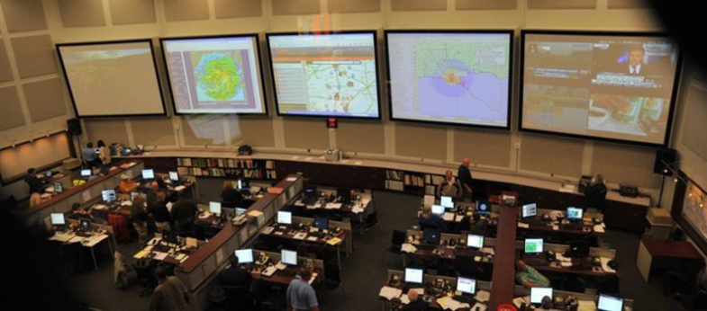
Office of Response
OFFICE OF RESPONSE

Slide 27
Office of Response
OFFICE OF RESPONSE
Daily oversight of the Operations Bureau, Communications Bureau, GIS Office, EMAC, and Field Services Bureau. This office is responsible for generating state information, warning and alerts, coordinating response efforts and staffs the State Emergency Operations Center (SEOC).

Slide 28
Operations Bureau
Development and management of situational information sharing tools to enhance overall state situation awareness both day to day and during events. (Which includes HSIN, WebEOC, MEMA COP, etc.)
Establish and maintain standard operating procedures (SOP) to manage the SEOC and its function.
Coordinate Mutual Aid (MA) and Emergency Management Assistance Compact (EMAC) request, documentation, and reimbursement submissions.

Slide 29
Operations Bureau
Assist in the coordination and development of SEOC physical security plans and SOPs.
Supports damage assessment after an event and assists with the transition to the recovery phase.
These functions are directed toward the goal of minimizing the risk and affect to people, property and the environment.

Slide 30
Communications Bureau
Designated state warning point that operates 24 hours a day, 7 days a week.
Responsible for alerting state and local officials to all natural or man-made incidents throughout the state.
Alerts include severe thunderstorms, tornadoes, hurricanes, earthquakes or hazardous materials incidents.

Slide 31
Communications Bureau
Communications capabilities include satellite, low band, UHF radios and AtHoc.
AtHoc is a multi-device notification system that has enhanced the ability to rapidly communicate essential information to the field.
The AtHoc Notification System allows for rapid notification of all federal, state and local personnel.

Slide 32
GIS
Office of Geospatial Information Systems (GIS) provides GIS products, mapping and technical support to MEMA all 82 counties and the Mississippi Band of Choctaw Indians.
GIS develops and maintains:
MEMA’s Common Operating Picture (COP)
Damage Assessment’s
County United Stated National Grid (USNG) Maps and special mapping products required in support of events and incidents

Slide 33
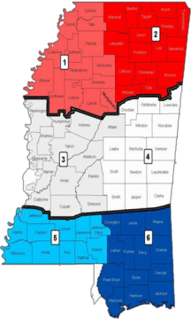
Field Services Bureau
This office assists counties with the Emergency Management Performance Grant (EMPG) application and standards, (including emergency management grants) and is responsible for maintaining the Statewide Mutual Aid Compact (SMAC).

Slide 34
Field Services Bureau
Comprised of a Director, six Area Coordinators (AC), two Field Service Specialists, and a Grants/Administrative Assistant.
All members of this bureau are on-call 24 hours a day.
ACs are assigned to the six MEMA-established districts within the state and are the Executive Director’s liaisons to the local jurisdictions for emergency management activities prior to, during and post crisis incidents.

Slide 35
Field Services Bureau
On a day-to-day basis, ACs assist the County EMA Directors, municipalities with all aspects of emergency management including planning, training, exercise, mitigation, and recovery.
Field Service Specialists are Area Coordinators based out of MEMA Pearl. The Field Services Specialists perform the same duties as the ACs, with additional responsibilities of:
Maintaining operational control of the State Emergency Response Team (SERT) trailers

Slide 36
Field Services Bureau
Maintaining operational control of forward Operations Centers
Being prepared to assist with the conduct of damage assessments after a disaster
Maintaining a capability to conduct localized UAS/Drone- support to EMAs

Slide 37
Field Services Bureau
Field Service Grants/Administrative Assistant is also based out of MEMA Pearl and primarily performs the following duties:
Executes quality control over all grant paperwork prior to being delivered to the Executive level for review and approval.
Creates professional documents and coaches Field Service Bureau members through the administrative paperwork of their duties.

Slide 38
Office of Recovery
OFFICE OF RECOVERY
Hurricane Nate

Slide 39
Office of Recovery
OFFICE OF RECOVERY
This office is comprised of the Public Assistance Bureau. This bureau works to provide assistance to citizens, local governments, non-profit associations, state agencies and businesses to help aid in recovery from disasters.

Slide 40
Public Assistance
During a Presidential Disaster Declaration, Public Assistance programs can help provide federal grants to local and state governments, as well as non-profit organizations and other political subdivisions, for the repair, replacement or restoration of disaster-damaged, publicly owned facilities.

Slide 41
Public Assistance
Provided through the following programs:
Small Business Administration (SBA): During SBA or Presidential Disaster Declarations, the SBA can offer low-interest loans to disaster victims.
Public Assistance (PA) administers a Federal Grant that assists local Governmental Agencies and certain Private Non-Profit organizations who incur damage(s) as a direct result of a Federal Declared disaster.

Slide 42
Public Assistance
Under the PA reimbursement program, there are two types of public assistance authorized: “emergency” and “permanent” work.
Emergency work includes efforts to save lives, protect property, maintain operation of essential facilities which must be completed within 6 months.
Permanent work involves actions necessary to repair, restore, reconstruct and/or replace public and certain private non-profit facilities damaged or destroyed by the disaster.

Slide 43
Public Assistance
Must be completed within 18 months of the event.
“Public damages” can include any damage incurred by a structure or facility which is either owned by or the responsibility of a public or private non-profit entity. This could include roads, bridges, buildings, utilities, etc.

Slide 44
Public Assistance
Project applications for public sites may be approved to fund a variety of projects that fall within the following eligible categories:
Category A: Debris Clearance
Category B: Emergency Protective Measures
Category C: Road System
Category D: Water Control Facilities
Category E: Building and Equipment
Category F: Public Utility Systems
Category G: Other

Slide 45
Private Nonprofit
Houses of Worship
Private nonprofit houses of worship are now eligible for disaster assistance as community centers, effective for disasters declared on or after August 23, 2017 and for applications for assistance that were pending with FEMA as of that date, including applications on first- or second-level appeal that have not yet been resolved.
Change will be reflected in the 3rd edition of the Public Assistance Program Policy Guide at:
www.fema.gov/media-library/assets/documents/111781.

Slide 46
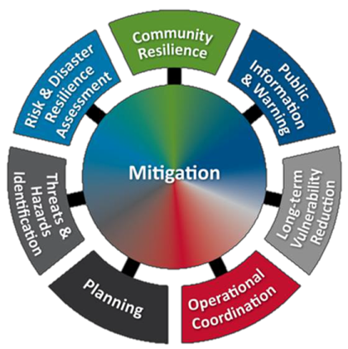
Office of Mitigation
OFFICE OF MITIGATION

Slide 47
Office of Mitigation
OFFICE OF MITIGATION
This office is responsible for coordinating disaster loss reduction programs, initiative and policies throughout the state. Disaster loss reduction measures are carried out through the development of state and local hazard mitigation plans and the implementation of those plans.

Slide 48
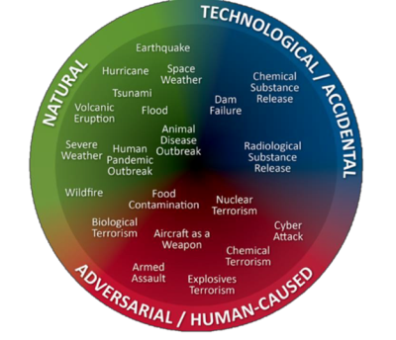
Office of Mitigation
Mitigation is the ongoing effort to lessen or eliminate the impact disasters have on people’s lives and property through damage prevention and flood insurance.
Hazard mitigation is the cornerstone of emergency management.
Examples of Threats
and Hazards by Category

Slide 49
Office of Mitigation
State and local mitigation strategies that qualify for funding:
Hazard mitigation planning
Retrofit of critical facilities
Acquisition, elevation, relocation and/or drainage improvements of repetitive flood loss structures
Construction and/or upgrade of general population shelters
Enhancement of development codes and standards
Safe rooms and storm shelters
Generators for critical facilities
Warning systems

Slide 50
Office of Mitigation
Office of Mitigation administers Hazard Mitigation Grant Programs to state and local governments, qualifying nonprofits and tribal organizations.
Grant programs include the post-disaster Hazard Mitigation Grant Program, the Flood Mitigation Assistance Program, the Pre-Disaster Mitigation Program and the Severe Repetitive Loss Grant Program, which funds the mitigation of high loss insured properties through the National Flood Insurance Program.

Slide 51
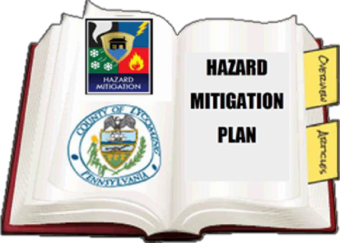
Office of Mitigation
To qualify for mitigation grants, state and local governments are required to develop and implement hazard mitigation plans.

Slide 52
Office of Mitigation
State Hazard Mitigation Plan:
Identifies the major natural hazards that affect our state
Assesses the risk that each hazard poses,
Projects the vulnerability of our people, property and infrastructure to the specific hazard and
Recommends actions that can be taken to reduce the risk and vulnerability to the hazard.
Contains a description of programs, policy, statues and regulations applicable to hazard mitigation.

Slide 53
Office of Mitigation
Permanent work involves actions necessary to repair, restore, reconstruct and/or replace public and certain private non-profit facilities damaged or destroyed by the disaster.
Must be completed within 18 months of the event.
“Public damages” can include any damage incurred by a structure or facility which is either owned by or the responsibility of a public or private non-profit entity. This could include roads, bridges, buildings, utilities, etc.

Slide 54
Office of Outreach Services
OFFICE OF OUTREACH SERVICES
Comprised of MEMA 4 Kids Campaign, Individual Assistance, the Disaster Reservists Bureau, the Disability Integration Advisor and also includes MEMA’s effort to work with numerous volunteer organizations before, during and after a disaster.

Slide 55
Office of Outreach Services
MEMA4Kids

Slide 56
Disaster Reservists
DR Program provides trained personnel immediately after an event to serve in various functions on an on- call basis. Reservists are state Other Personal Services (OPS) employees working on a temporary, intermittent basis.
Reservists are a flexible pool of disaster staff that can function in many roles and augment Emergency Management personnel in preparing for, responding to, recovering from, and mitigating All-Hazards in order to accomplish the mission by performing a variety of emergency management functions.

Slide 57
Disability Integration
Provides day-to-day leadership, advice and guidance in all aspects of emergency management in order to ensure individuals with disabilities of all ages are provided equal access, receive timely and appropriate services and are fully integrated into planning, response and recovery activities in a disaster.
MEMA’s goal is to lead the nation in serving people with disabilities or functional needs.

Slide 58
Individual Assistance
During a Presidential Disaster Declaration, Individual Assistance (IA) programs can aid homeowners and renters with housing needs and necessary assistance.
IA also:
Establishes and maintains Disaster Recovery Centers following declared disasters.
Ensures recovery services are accessible to all Mississippians through MEMA’s Disability Integration Advisor.

Slide 59
Individual Assistance
State Temporary Housing Program:
During non-Presidential Disaster Declarations, the program may be able to reimburse rental costs to citizens who are displaced from their homes for more than 72 hours.

Slide 60
Office of Support Services
OFFICE OF SUPPORT SERVICES

Slide 61
Office of Support Services
OFFICE OF SUPPORT SERVICES
The office of Support Services maintains budgets, payroll, accounting and finance, grants management, purchasing, property, facilities maintenance and information technology.

Slide 62
Emergency Management
Performance Grant (EMPG)
EMPG is a 50 percent reimbursable federal grant within the Department of Homeland Security. It is administered by MEMA.
– This means you will first spend your money, then MEMA will reimburse half of the total amount.

Slide 63
EMPG
Funds support comprehensive emergency management at the state, tribal, and local levels and to encourage the improvement of mitigation, preparedness, response, and recovery capabilities for all hazards and threats.
Funds CANNOT be matched with any other federal funding source. (Refer to the NOFO-Notice of Funding Opportunity).
Must be matched with county general or other local funds.

Slide 64
EMPG Eligible Costs
What is eligible?
What is not eligible?
Salary and fringe
Emergency Management related expenses
General, day-to-day operating costs (utility bills, supplies, etc.)
Public outreach/education
Food
Search and Rescue
Hazmat
Fire gear
Clothing
Weapons
Expenses billed to departments other than Emergency Management
***THIS IS NOT A COMPLETE LIST***

Slide 65
EMPG Required Documents
The following documents must be submitted within the given timeframe (Varies from year to year):
Program Agreement
Application/Work Plan
EMPG Required Standards
Other required documents:
Change of scope form (if applicable)
Reimbursement Forms, accompanying documentation
Final Performance and Expenditure Report (Closeout documents)

Slide 66
MEMA 101
Unit 3:
National Incident
Management System (NIMS)

Slide 67
Unit 3 Objectives
At the end of this unit, you will be familiar with:
History of NIMS
The importance of implementing NIMS
Incident Command System (ICS)
HSPD-5 and PPD8
National Response Framework
Stafford Act
Training Guidance

Slide 68
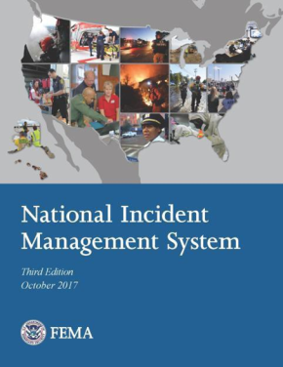
NIMS History and Implementation
All State, territory, local and tribal jurisdictions that receive Federal Performance Assistance Grants must implement the NIMS per Homeland Security Presidential Directive 5 (HSPD-5) Management of Domestic Incidents.

Slide 69
NIMS History and Implementation
NIMS Implementation FY 2005 and FY 2006
– Self Certification – Official Letters submitted
– Governor issues Executive Order 932 (March 2005)
Governor’s Executive Order 932
– Mandates use of NIMS in MS during emergencies and disasters.
– Initial measures reached and “good faith efforts” underway to achieve compliance with requirements.

Slide 70
Incident Command System

Slide 71
Incident Command System
Incident Command System
A standardized approach to the command, control, and coordination of emergency response providing a common hierarchy within which responders from multiple agencies can be effective.

Slide 72
HSPD-5: Management of
Domestic Incidents
Intended to enhance the ability of the U.S. to manage domestic incidents.
2003 directive described federal policies and objectives; identified steps to improve federal, state, and local incident coordination; and directed the Secretary of Homeland Security to create a National Response Framework and NIMS.

Slide 73
PPD-8: National Preparedness
PPD-8 was issued as a companion directive to HSPD-5 to establish policies strengthening
U.S. preparedness to prevent and respond to domestic terrorist attacks, major disasters, and other emergencies.
Directive required the Secretary of Homeland Security to develop a national domestic all-hazards preparedness goal that included “measurable readiness priorities and targets” and “readiness metrics and elements.”

Slide 74
PPD-8: National Preparedness
Directive also required federal agencies to:
Provide financial and technical support to states
Develop first responder equipment standards
Establish training programs to meet national preparedness goals.
HSPD-8 Annex 1 addressed the development of a standardized national planning process and scenarios for emergencies.

Slide 75
PPD-8: National Preparedness
In March 2011, President Obama issued Presidential Policy Directive-8 (PPD-8), which replaced HSPD-8 and HSPD-8 Annex 1 with the exception of paragraph 44 in Annex 1.
The new national preparedness directive retains an all-hazards, risk-based approach to national preparedness, while establishing four categories of hazards: terrorism, catastrophic natural disasters, cyber attacks, and pandemics.

Slide 76
National Response Framework
National Response Framework
DHS released the National Response Plan (NRP) in December 2004.
Homeland Security Act directed DHS to establish a framework to coordinate federal resources during emergencies.
NRP was replaced in January 2008 by the National Response Framework (NRF) and updated in May 2013.

Slide 77
National Response Framework
NRF is:
Implemented by the FEMA.
Is not a source of legal authority for incident response.
It is used to guide response activities that arise from events of all sizes, whether an emergency is declared or not.

Slide 78
National Response Framework
NRF uses:
A national, all-hazards approach that describes and integrates roles for federal, state, local, territorial, and tribal governments and the private sector in preparing, responding, and recovering from incidents.
NIMS to coordinate response activities among governments and organizations at all levels. States have looked to the NRF as a way to structure their response plans.

Slide 79
Organization of the National Response Framework

Slide 80
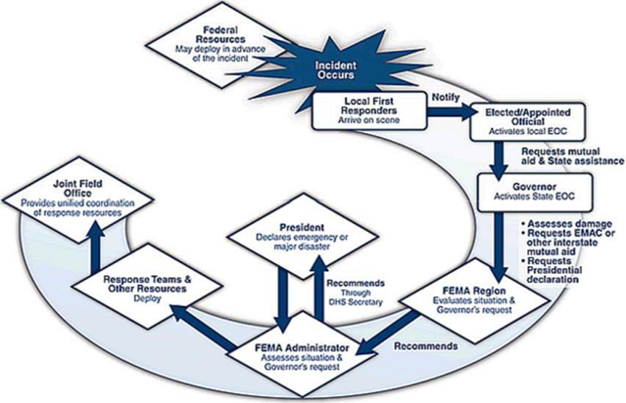
Robert T. Stafford Act
Robert T. Stafford Act

Slide 81
Robert T. Stafford Act
Robert T. Stafford Disaster Relief and Emergency Assistance Act of 1988 (Stafford Act) provides the legal authority for the federal government to provide assistance to states during declared major disasters and emergencies.

Slide 82
Robert T. Stafford Act
Stafford Act authorizes the delivery of federal technical, financial, logistical, and other assistance to states and localities during declared major disasters or emergencies.
FEMA coordinates administration of disaster relief resources and assistance to states. Federal assistance is provided under the Stafford Act if an event is beyond the combined response capabilities of state and local governments.

Slide 83
2018 NIMS Training Guidance
Elected Officials Recommended:
IS-700c: NIMS, An Introduction
IS-100b: Introduction to the Incident Command System (ICS)
IS-200b: ICS for Single Resources and Initial Action Incident
IS-800c: National Response Framework, An Introduction
ICS 402: ICS Overview for Executives/Senior Officials

Slide 84
2018 NIMS Training Guidance
First Line Supervisors and Entry level Personnel Requirements:
IS-700c: NIMS, An Introduction
IS-100b: Introduction to the Incident Command System (ICS)
IS-200b: ICS for Single Resources and Initial Action Incident
IS-800c: National Response Framework, An Introduction

Slide 85
2018 NIMS Training Guidance
Middle Management and EOC Staff
IS-700c: NIMS, an Introduction
IS-100b: Introduction to ICS
IS-200b: ICS for Single Resources & Initial Action Incident
IS-800c: National Response Framework, An Introduction
G-300: Intermediate ICS for Expanding Incidents
IS-702a-Public Information Systems
IS-703a-NIMS Resource Management

Slide 86
2018 NIMS Training Guidance
Upper Management, EMA Director and Deputy Director
IS-700c: NIMS, an Introduction
IS-100b: Introduction to ICS
IS-200b: ICS for Single Resources & Initial Action Incident
IS-800c: National Response Framework, An Introduction
G-300: Intermediate ICS for Expanding Incidents
G 400: Advanced ICS
IS-702a-Public Information Systems
IS-703a-NIMS Resource Management

Slide 87
MEMA 101
Unit 4:
MISSISSIPPI EMERGENCY
MANAGEMENT LAW

Slide 88
Unit Objectives
At the end of this, you will be able to:
Provide response information as it pertains to the Emergency Management Law.
Know the types of disasters
Understand the MS State Comprehensive Emergency Management Plan (CEMP)

Slide 89
Purpose and Policy §33-15-3
The legislature has determined it necessary to:
Establish a state emergency management agency, Mississippi Emergency Management Agency (MEMA)
Establish emergency powers of the Governor, MEMA, and local officials
Authorize creation of local government Emergency Management (EM) organizations
Authorize mutual-aid among local, state and Federal government

Slide 90
Purpose and Policy §33-15-3
Necessary to provide the means for mitigation of emergencies.
The purpose of this law and the policy of Mississippi is to coordinate the state’s emergency management, to the maximum extent possible, with the comparable functions of the federal government, other states and private agencies so the most effective preparedness actions may be taken.

Slide 91
Disasters
Disasters
Disasters refer to any natural, technological or civil emergency that causes damage of sufficient severity and magnitude to result in a declaration of a state of emergency by a city, the county, the Governor, or the President of the United States.

Slide 92
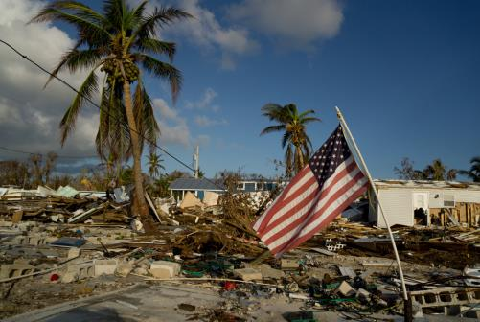
Types of Disasters
Catastrophic Disaster – A disaster that will require massive state and federal assistance, including immediate military involvement.

Slide 93
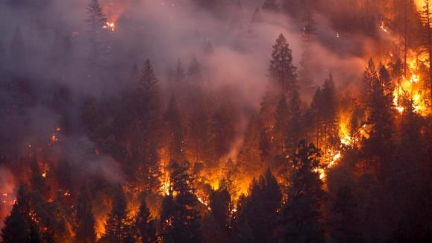
Types of Disasters
Major Disaster – A disaster that will likely exceed local capabilities and require a broad range of state and federal assistance.

Slide 94
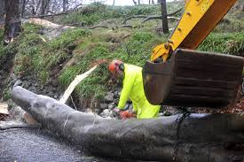
Types of Disasters
Minor Disaster - A disaster that is likely to be within the local response capabilities and results in only a minimal need for state or Federal assistance.

Slide 95
MEMA §33-15-7
MEMA §33-15-7
In accordance with§33-15-7, the Mississippi Emergency Management Agency (MEMA) was established and the Executive Director was appointed by the Governor.

Slide 96
MEMA §33-15-7
(a) There is hereby created within the executive branch of the state government a department called the Mississippi Emergency Management Agency with a director of emergency management who shall be appointed by the Governor; he shall hold office during the pleasure of the Governor and shall be compensated as determined by any appropriation that may be made by the Legislature for such purposes.

Slide 97
MEMA §33-15-7
(b) The director, with the approval of the Governor, may employ such technical, clerical, stenographic and other personnel, to be compensated as provided in any appropriation that may be made for such purpose, and may make such expenditures within the appropriation therefor, or from other funds made available to him for purposes of emergency management, as may be necessary to carry out the purposes of this article.

Slide 98
MEMA §33-15-7
The director and other personnel of the emergency management agency shall be provided with appropriate office space, furniture, equipment, supplies, stationery and printing in the same manner as provided for other state agencies.

Slide 99
MEMA §33-15-7
(d) The director, subject to the direction and control of the Governor, shall be the executive head of the emergency management agency and shall be responsible to the Governor for carrying out the program for emergency management of this state. He shall coordinate the activities of all organizations for emergency management within the state, and shall maintain liaison with and cooperate with emergency management agencies and organizations of other states and of the federal government, and shall have such additional authority, duties, and responsibilities authorized by this article as may be prescribed by the Governor.

Slide 100
MEMA §33-15-7
Executive Directors duties:
Carry out the program for EM of this state.
Coordinate the activities of all organizations for emergency management within the state.
Maintain liaison and cooperation with emergency management agencies and organizations of other states and the federal government.

Slide 101
MEMA §33-15-7
Emergency Management Powers of the Governor
– Governor has general direction and control of MEMA; in the event of a disaster beyond local control, may assume direct
operational control over all or any part of Emergency Management functions within the state.

Slide 102
MEMA §33-15-7
Governor may:
Make, amend, and rescind orders, rules and regulations to carry out these provisions of law.
Work with MEMA to create the CEMP
Take preparedness actions
Cooperate with the President and the heads of the Armed Forces, FEMA, and with the officers and agencies of other states
Direct state and local law enforcement
Empower the state Board of Health to secure compliance with these laws

Slide 103
MEMA §33-15-7
Governor may also:
Utilize the services & facilities of officers and agencies of state & political subdivisions.
Establish agencies and offices as necessary to carry out the provisions of this article.
Delegate any authority vested in him and to provide
for the sub delegation of any such authority.

Slide 104
MEMA §33-15-7
Governor may also:
Enter into reciprocal aid agreements or compacts with other states and the federal government.
Sponsor and develop mutual aid agreements between political subdivisions of the state.
Suspend or limit sale or transportation of alcohol, firearms & combustibles.
Control, restrict, ration, freeze all goods & services.

Slide 105
MEMA §33-15-7
Governor may also:
– Proclaim a State of Emergency when conditions described in §33-15-5(g) exist, or when so requested by mayor or president of the board of supervisors, or when he finds local authority unable to cope with the emergency.

Slide 106
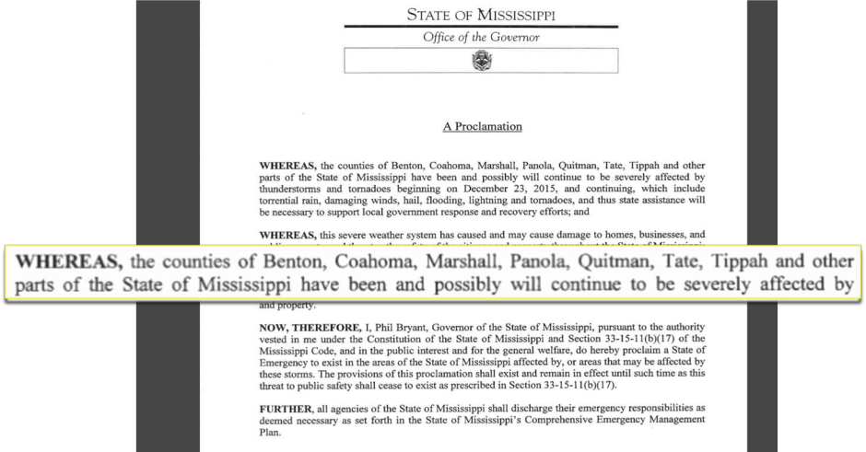
MEMA §33-15-7

Slide 107
MEMA §33-15-7
Declare an emergency impact area when he finds that the conditions described in§33-15- 5(o) exist.
“Emergency impact area” means the area of the state in which market conditions exist due to a state of emergency creating a likelihood that prices ordinarily charged for goods and services could be raised unfairly due to the underlying emergency.

Slide 108
CEMP §33-15-14
CEMP §33-15-14
Suspend regulatory statutes prescribing the procedures for conduct of state business, or the orders, rules or regulations of any state agency, if regulation hinders action.
Redirect state government for emergency services.
Commandeer private property for the “common good.” (but not without compensation)

Slide 109
CEMP §33-15-14
MEMA is responsible for maintaining a comprehensive statewide program of emergency management.
MEMA shall prepare an interim post disaster
response and recovery component that substantially complies with the previously mentioned provisions.

Slide 110
CEMP §33-15-14
Each state agency assigned lead responsibility for an
emergency support function by the CEMP shall also prepare a detailed operational plan needed to implement its responsibilities.
http://www.msema.org/emergency-plans/state-cemp

Slide 111
Additional Duties §33-15-14
MEMA shall also:
Prepare Executive Orders/proclamations
Coordinate with the Federal Government
Assist political subdivisions with the creation and training of urban search and rescue teams
Development of the MS Disaster Reservist Program

Slide 112
Local Emergency Management Organizations §33-15-17
Each county and municipality may:

Slide 113
Local Emergency Management Organizations §33-15-17
Each county and municipality, or counties and the municipalities therein acting jointly, or two (2) or more counties acting jointly, shall establish a local organization for emergency management in accordance with the state emergency management plan and program, if required and authorized so to do by such state emergency management plan.

Slide 114
Mutual Aid Agreements §33-15-17
The governing body of a municipality or county is authorized to participate in the Statewide Mutual Aid Compact (SMAC).
SMAC provides guidelines for requesting and receiving mutual aid.
Locals are strongly encouraged to sign and ratify the SMAC.
To enact, the senior elected official must sign, send to MEMA, and the Emergency Management organization must keep on file.

Slide 115
Mutual Aid Agreements §33-15-17
Outside the state:
Locals may develop and enter into mutual aid agreements with jurisdictions outside the state.
Agreements must be sent to MEMA and must be consistent with the CEMP.
Governor may enter into compacts with any state
or group of states if he finds that joint action is desirable in meeting common intergovernmental problems of EM planning or emergency prevention, mitigation, response and recovery.

Slide 116
Additional Duties §33-15-14
MEMA shall also:
Prepare Executive Orders/proclamations
Coordinate with the Federal Government
Assist political subdivisions with the creation and training of urban search and rescue teams
Development of the MS Disaster Reservist Program

Slide 117
State, Local Personnel & Equipment §33-15-49
In the event of a disaster, and a Proclamation issued by governing authorities, city/county personnel may:
Venture onto private property to aid in removing debris
Perform any other necessary and needed services to prevent the spread of disease or any other health hazard to the community at large.

Slide 118
Disaster Assistance Act
Of 1993 §33-15-305
Governor’s Authorized Representative (GAR)
– The primary and alternate emergency management official designated by the Governor to administer federal assistance programs on behalf of the state and local governments and other grant or loan recipients and is responsible for the state compliance with the FEMA-State Agreement.

Slide 119
Disaster Assistance Coordination §33-15-403
Office of Disaster Assistance Coordination
Established within the Office of the Governor as the primary entity responsible for coordinating information regarding disaster assistance provided by federal agencies other than FEMA, by state agencies other than MEMA, and by other public and private entities that provide various types of assistance and benefits to victims of major natural disasters.

Slide 120
What to do now?
To Do List:
Know and understand statues, codes, ordinances and regulations that affect you and your profession.
Coordinate local ordinances with State Laws and all applicable federal codes and regulation. Misapplying State and Federal regulations can result in disallowance of disaster costs reimbursement.
Document actions and retain a record.

Slide 121
What to do now?
Discuss EM law with County Attorney and ensure local officials know of their emergency management responsibilities and powers.
Develop and maintain a close working relationship with your city/county officials and city/county attorney.

Slide 122
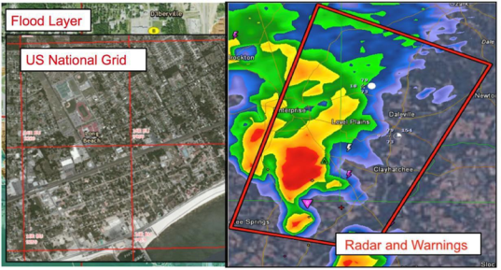
MEMA 101
Unit 5:
SITUATIONAL AWARENES
RESOURCE AND TOOLS

Slide 123
Unit Objectives
At the end of this unit, you will be able to:
Be familiar with situational awareness products/tools available to local jurisdictions to assist emergency/disaster response efforts.
Explain what critical information is needed on the MEMA Disaster Report forms.

Slide 124
Situational Awareness Tools
A Situation Occurs…
WHAT WOULD YOU DO?

Slide 125
What would you do?
Within 2 to 4 hours:
You should have a preliminary idea of the situation.
Establish Incident Command Post near area.
Complete and fax, submit through WebEOC, or call in an Initial Disaster Report (MEMA DR-1) to MEMA.

Slide 126
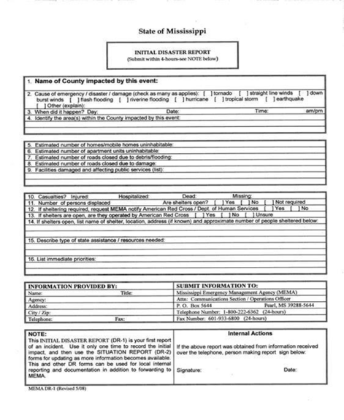
Disaster Reports (DR-1)
DR-1

Slide 127
Disaster Reports (DR-1)
Information Needed in a DR-1
What type damage has occurred?
Are people displaced? How many?
Are Shelters open? How many?
Are structures destroyed?
Is there major damage?
Is there minor damage?
Are structures habitable or usable?

Slide 128
Disaster Reports (DR-1)
Information Needed in a DR-1 cont.…
Number of structures?
Are utilities affected?
Injuries? Fatalities?
What actions have been taken so far?

Slide 129
Disaster Reports
Determine impact of Event
Is there a need for:
Proclamation of a Local Emergency
Request for Governor’s State of Emergency
Shelter openings
Providing food for victims and responders
Search and rescue
Emergency medical services

Slide 130
Disaster Reports (DR-3)
Local Proclamation of Emergency
Governing Body signs a Local Proclamation of Emergency MEMA DR-3.
Sets up the legal mechanism for response.
Assists in financial aspect of response.
Submit this document to MEMA with the Situation Report.

Slide 131
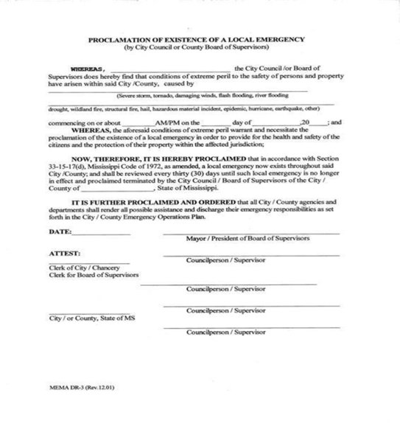
Local Proclamation (DR-3)
DR-3

Slide 132
Disaster Reports (DR-4)
Request a State of Emergency
Requesting State of Emergency (SOE) from the Governor (MEMA DR-4)
Elected Officials can make this request at the same time as the Local Proclamation.
Up to 30 days to request State of Emergency.
Not always granted with this request.
Starts the State response to your emergency.

Slide 133
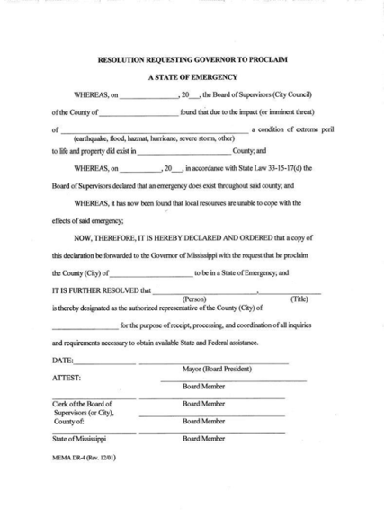
Request a State of Emergency (DR-4)
DR-4

Slide 134
Situation Reports
Situation Reports:
Complete Situation Report form, MEMA DR-2, and submit to MEMA
Update Situation Report every 24 hours or as circumstances change better or worse.
Mark last report as FINAL

Slide 135
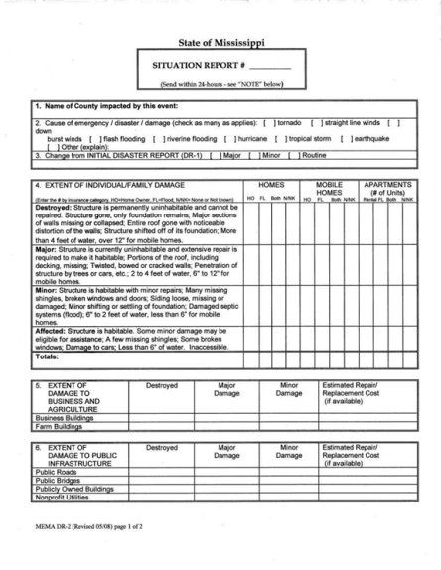
Damage Reports (DR-2)
DR-2
Page 1 of 2

Slide 136
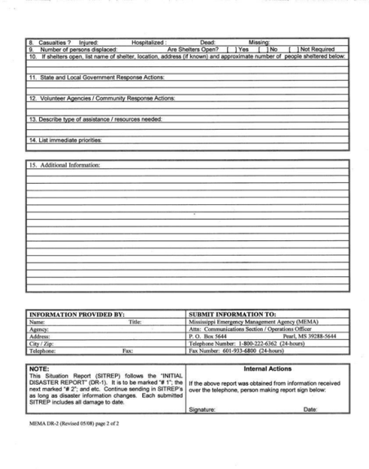
Damage Reports (DR-2)
DR-2
Page 2 of 2

Slide 137
Local Damage Assessment
Within 24 hours, if possible, send in Damage Assessment forms (MEMA DA-1, 2, 3) with information on:
Damage location(s)
Estimate dollar amount(s)
Residential, commercial, and/or government infrastructure

Slide 138
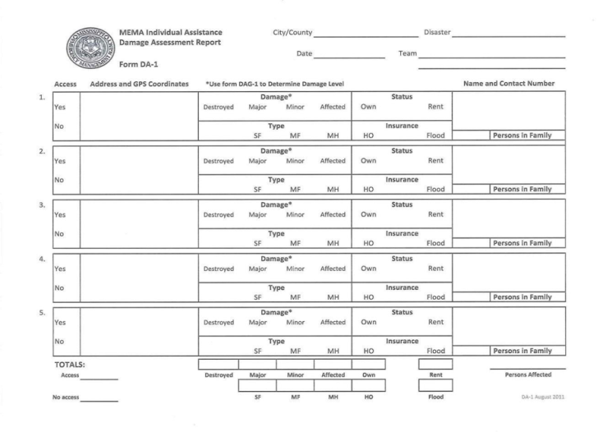
Damage Assessment (DA-1)
DA-1

Slide 139
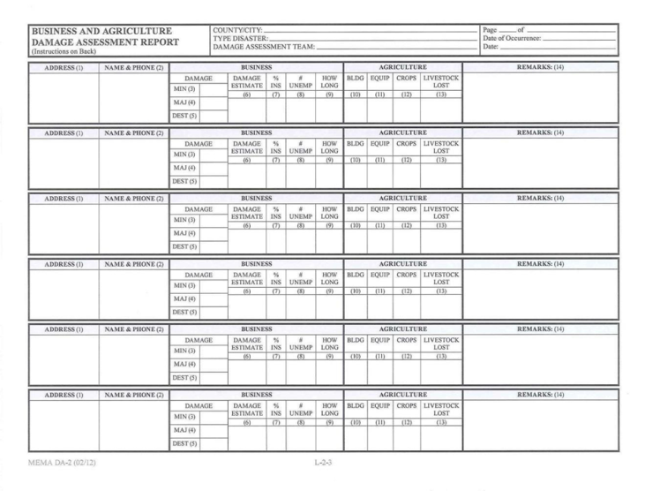
Damage Assessment (DA-1)
DA-2

Slide 140
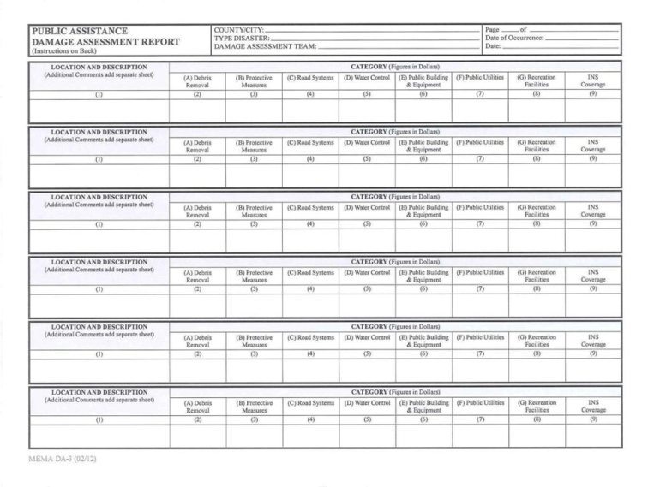
Damage Assessment (DA-1)
DA-3

Slide 141
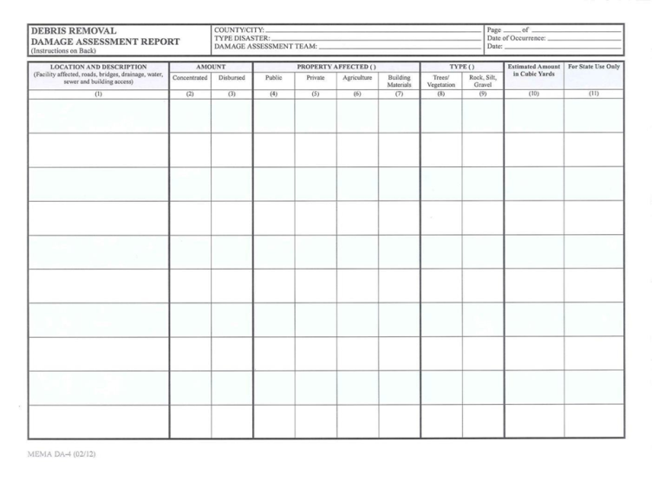
Damage Assessment (DA-1)
DA-4

Slide 142
Local Damage Assessment
As more information comes in:
How large will the response have to be?
Where will my staging area be?
What to do with donated goods?
Do we need volunteers from outside our jurisdiction?
Where will we house emergency responders?

Slide 143
Response becomes Recovery
The first 72 hours may be on you, so start helping your community immediately.
Find out where the needs are
Find out who has been displaced
Know where people have gone
Document, Document, Document!

Slide 144
State Response
Area Coordinator
State Emergency Response Team (SERT)
Individual Assistance (IA)
Public Assistance (PA)
Statewide Mutual Aid Compact
You can call on members of the compact.
SMAC/MEMA

Slide 145
SMAC
State Mutual Aid Compact
The Deployment of you and maybe your equipment to an affected area within the state.
All 82 counties, tribal government and some local jurisdictions have signed this.
Provides the state and locals with a database of resources that can be used in times of disaster and are close to affected area.

Slide 146
MCDEMA
Mississippi Civil Defense Emergency Management Association (MCDEMA) & Local Emergency Management Agency (EMA) Directors who can help with response
Other state agency response

Slide 147
EMAC
Emergency Management Assistance Compact
EMAC can pertain to all of the previous requirements and possibly more. The main difference is you are deployed out of the State of Mississippi.
Be prepared to stay in less than perfect conditions and be self sustainable.
Should you decide to self-deploy, you are on your own dime.
Be certain that you have a copy of your Mission Assignment in hand before departure.

Slide 148
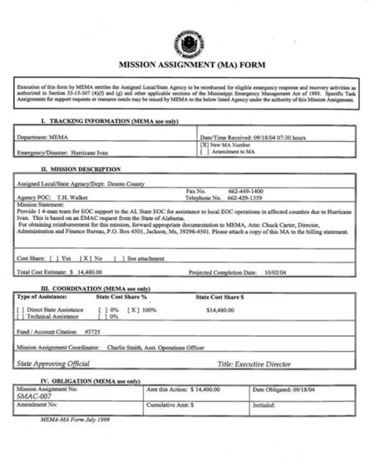
Mission Ready Package

Slide 149
Federal Declaration
Steps to request a Federal Declaration
Be prepared for a possible visit from the Governor within 24 hours.
Preliminary/Joint Damage Assessment
Information is given to the Governor (or designated authority/representative)
Governor requests, in writing, a Federal Disaster Declaration
FEMA will give a reply

Slide 150
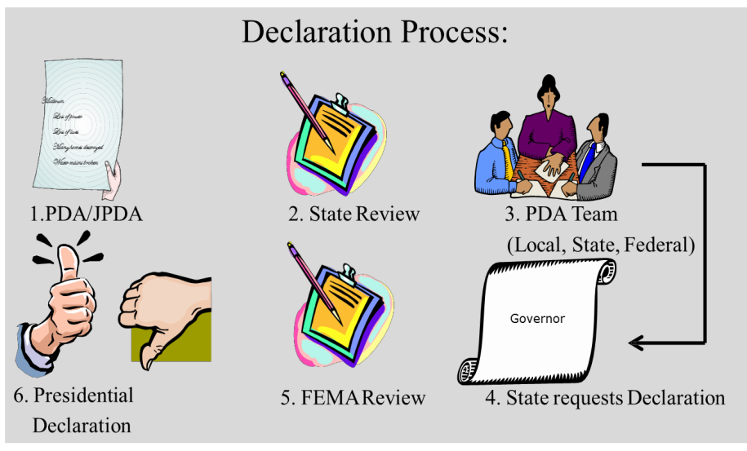
Federal Declaration Process

Slide 151
Other Considerations
Be prepared for a Media blitz
Designate a Public Information Officer (PIO) to respond to media requests and handle rumor control
Establish a Joint Information Center (JIC) for media
Be ready to be on national TV

Slide 152
MEMA 101
Situational Awareness Technology
WebEOC
Collector Application
Common Operating Picture (COP)
Daily Update Brief
Homeland Security Information Network (HSIN) Situation Room
Mobile App

Slide 153
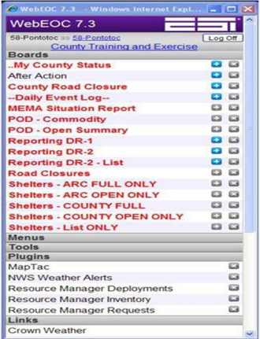
WebEOC
A Request for Assistance (RFA) can be submitted in Resource Manager and tracked in WebEOC.

Slide 154
Collector Application
Benefits and Activities performed in the Field:
Replace paper map books.
Map key infrastructure.
Collect points, lines and polygons.
Include images and/or videos.
Share info in real-time when connected.

Slide 155
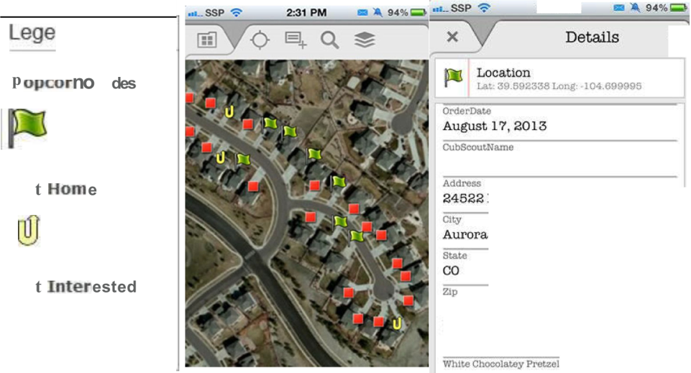
Collector Application

Slide 156
Common Operating Picture (COP)
COP:
Provides detailed mapping for planning, response and recovery operations state-wide.
COP provides real-time situational awareness based on data that is dynamically collected from WebEOC.

Slide 157
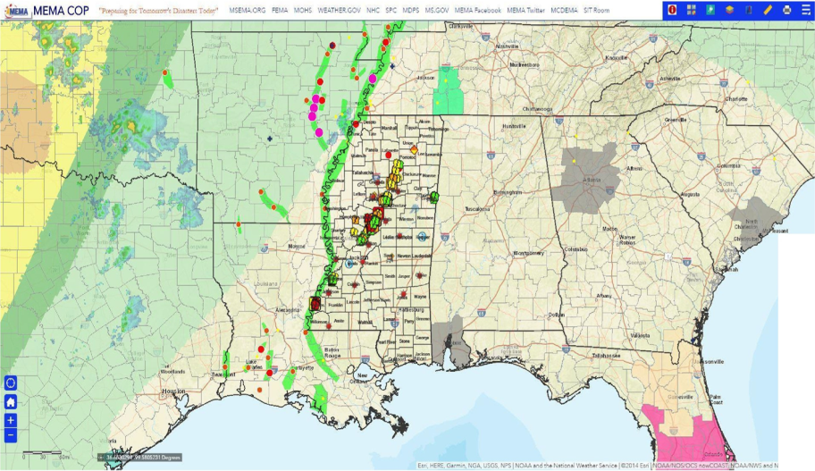
Common Operating Picture (COP)

Slide 158
Daily Update Brief

Slide 159
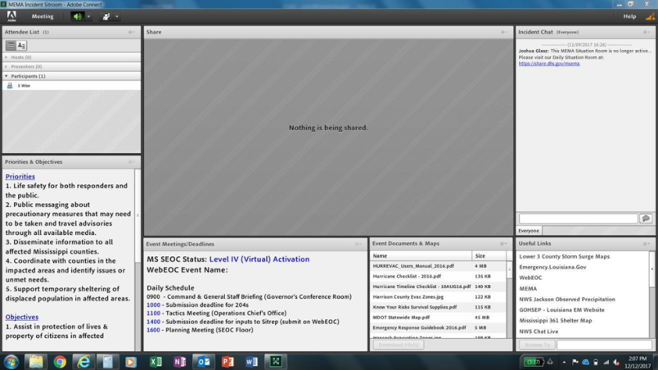
Homeland Security Information Network
Situation Room
HSIN

Slide 160
Mobile App
Mobile App

Slide 161
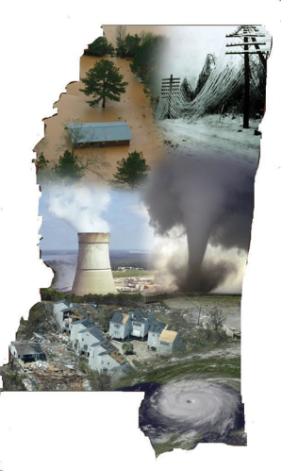
MEMA 101
Unit 6:
COURSE
SUMMARY

Slide 162
Course Summary
You should now be familiar with:
MEMA’s Organizational Structure
National Incident Management System (NIMS)
Emergency Management Law
Situational Awareness Resources and Tools

Slide 163
MEMA 101
Questions?

Slide 164
Acknowledgement
I ____________, have received, read and understand the MEMA 101 presentation.
______________ _____________
Loretta S. Thorpe Name/County
Bureau Director-Training
__________________________ ______________________
Date Date
Note: Please fax form to the training bureau at 601-933-6815

