Slide 1
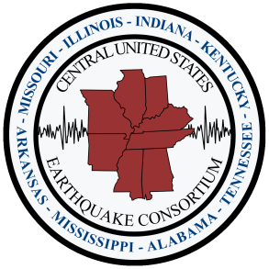
Earthquake Hazards in the Central U.S.
Brian Blake
Central U.S. Earthquake Consortium
MEMA SAR Planning Meeting
July 24, 2013
Senatobia, Mississippi

Slide 2
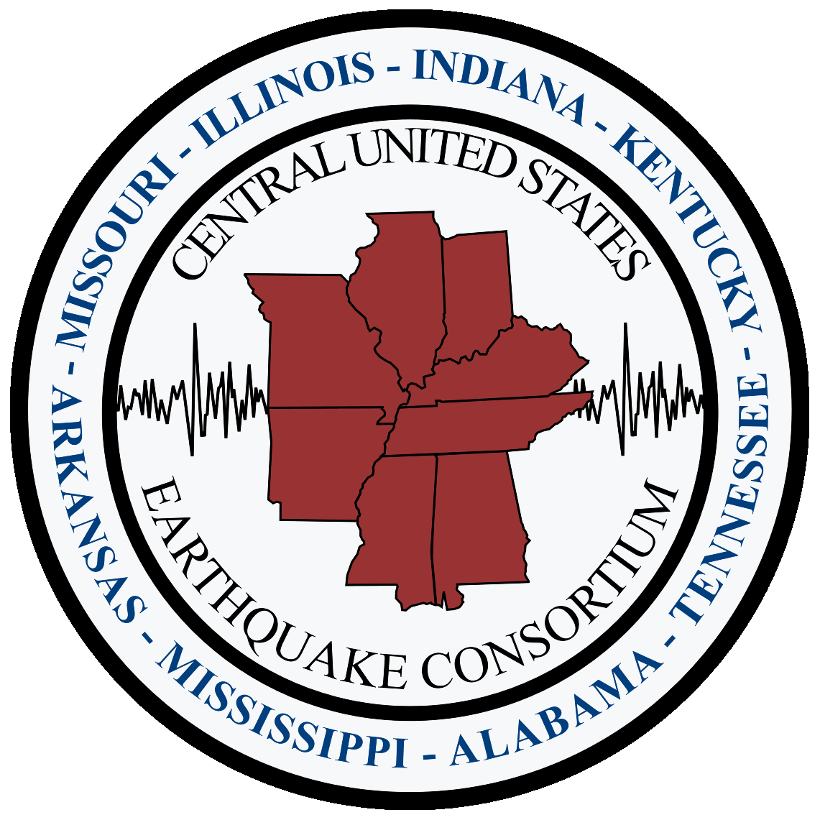
Overview of CUSEC
Formed in 1983
  Result of a growing body of research
  Partnership effort between State and Federal Government
NEHRP
Board of Directors
Eight Member States
Key Partnerships

Slide 3
Presentation Overview
Earthquake Hazards & Scenario
Earthquake Considerations for SAR
CAPSTONE-14 Exercise

Slide 4
Terminology
Epicenter
Magnitude vs. Intensity
Amplification
Liquefaction

Slide 5

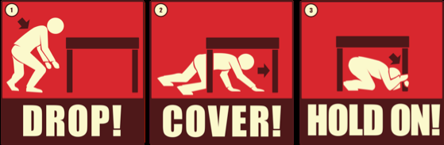

How to Protect Yourself During an Earthquake
Drop to the floor
Take Cover
Hold On to it firmly
  If inside, stay inside!
  If outside, stay outside!
Image Source: Southern California Earthquake Center
Notes:
5

Slide 6
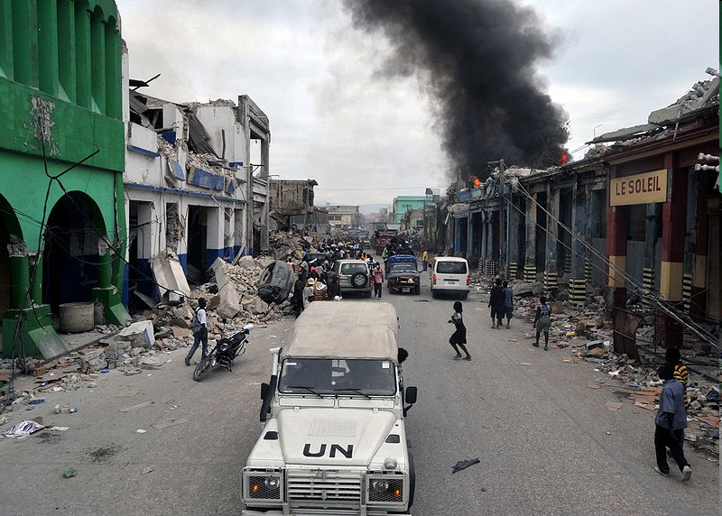
International Earthquake Reminders
2003 - Bam Iran
2004 - Indian Ocean
2008 - Sichuan China
Haiti Earthquake
  January 12, 2010
  M7.0
  230k lives lost
  1M homeless
  250k + buildings collapsed
Image Source: Marcello Casal Jr, WikiMedia
Notes:
Earthquakes over the last 10 years
- killed nearly 1,000,000 people combined
- Many of these quakes have struck large population centers

Slide 7
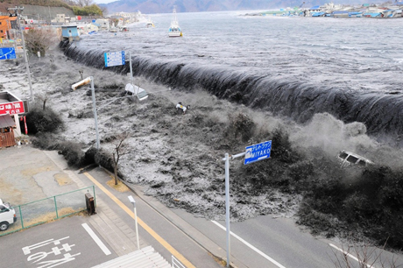
Tōhoku Earthquake and Tsunami
March 11, 2011
M9.0
Duration of Shaking
15,000 Fatalities
4M without Power
1.5M without Water
$300B in Damages
Image Source: Reuters

Slide 8
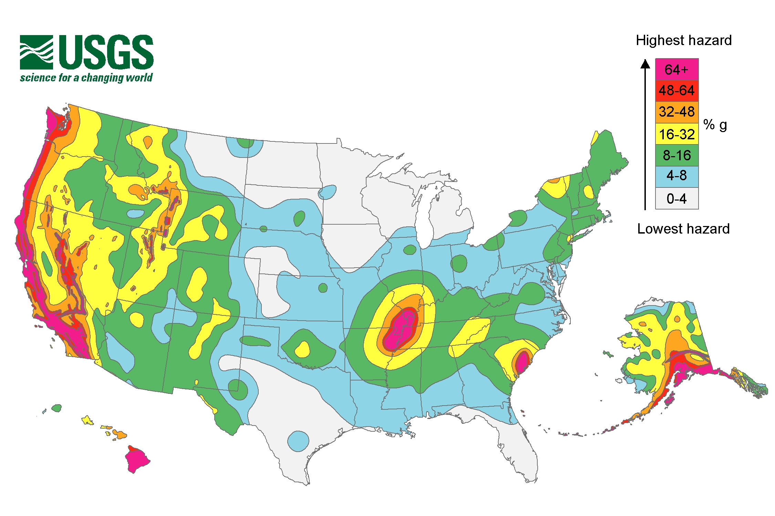
Map Source: US Geological Survey

Slide 9
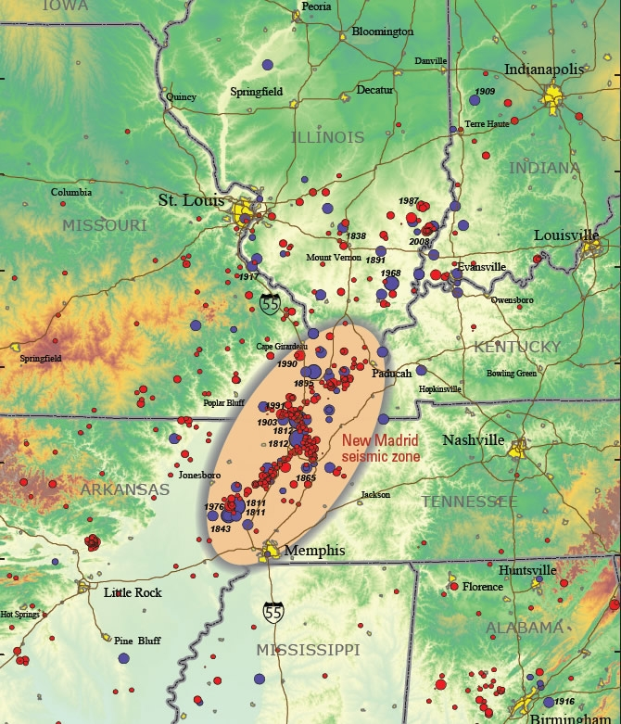
Earthquakes in the Central US
New Madrid Seismic Zone
Wabash Valley Seismic Zone
Appalachian/East Tennessee Seismic Zone
Map Source: US Geological Survey

Slide 10
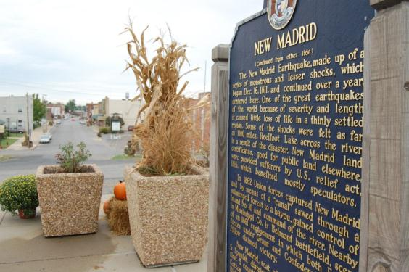
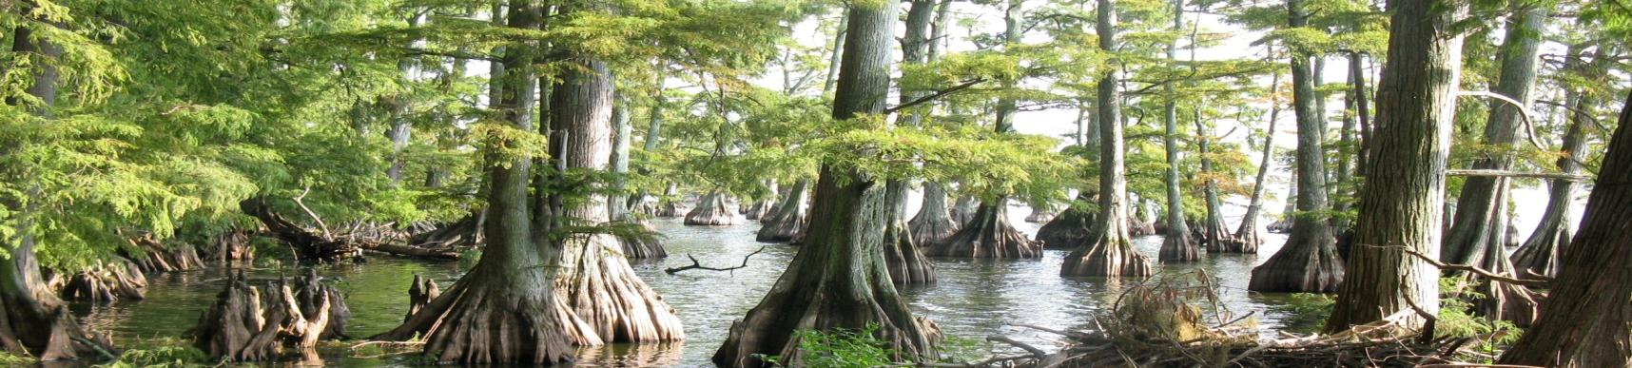
The New Madrid Earthquakes of 1811-12
Winter of 1811-12
M7-8.0
Thousands of Aftershocks
Lasting Effects

Slide 11
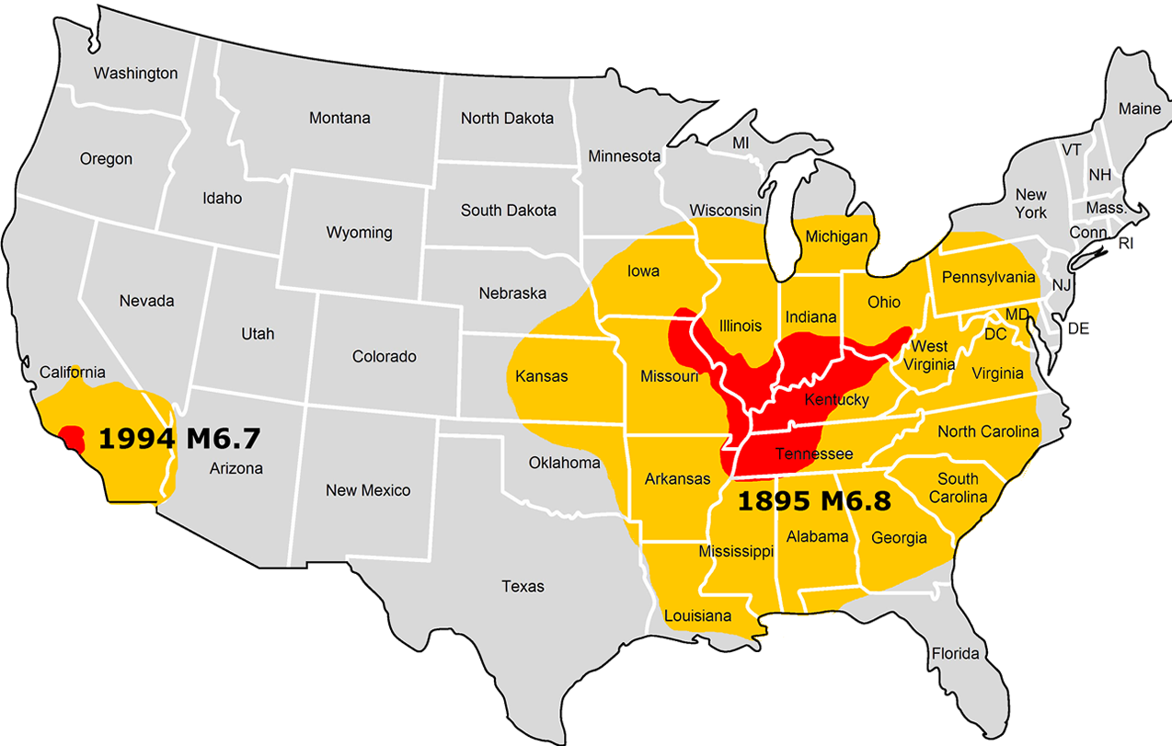
Central U.S. vs. California Earthquakes
Northridge, CA
Charleston, MO
Shaking felt, little to no damage
Minor to major damage to buildings and contents
Map Source: US Geological Survey

Slide 12
Mt. Carmel, IL Earthquake
4/18/2008
M5.2
Mt. Carmel, IL
Felt in 16 States
38,274 Reports
Maximum Intensity VII
Damage in 3 states
Map Source: US Geological Survey

Slide 13
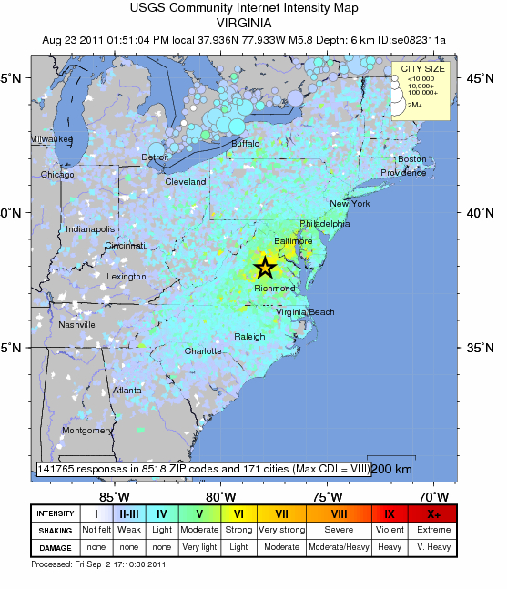
Mineral, VA Earthquake
8/23/2011
M5.8
Felt over the entire eastern seaboard
148,000 + felt reports
Maximum Intensity VII
Largest earthquake in 50+ years in the region
Map Source: US Geological Survey

Slide 14
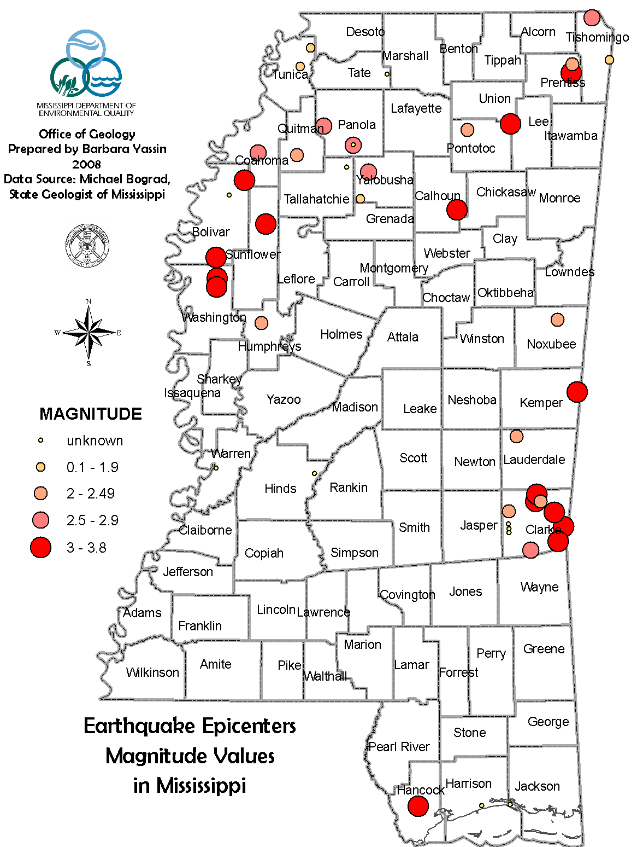
Earthquakes in Mississippi
December 17, 1931
Charleston, MS
Magnitude 4.6 @ 3:30AM
  Intensity VI
  Largest Earthquake in state history
  That’s only 30 miles from here!
Chimney Damage, Walls and Foundation Damage to High School

Slide 15
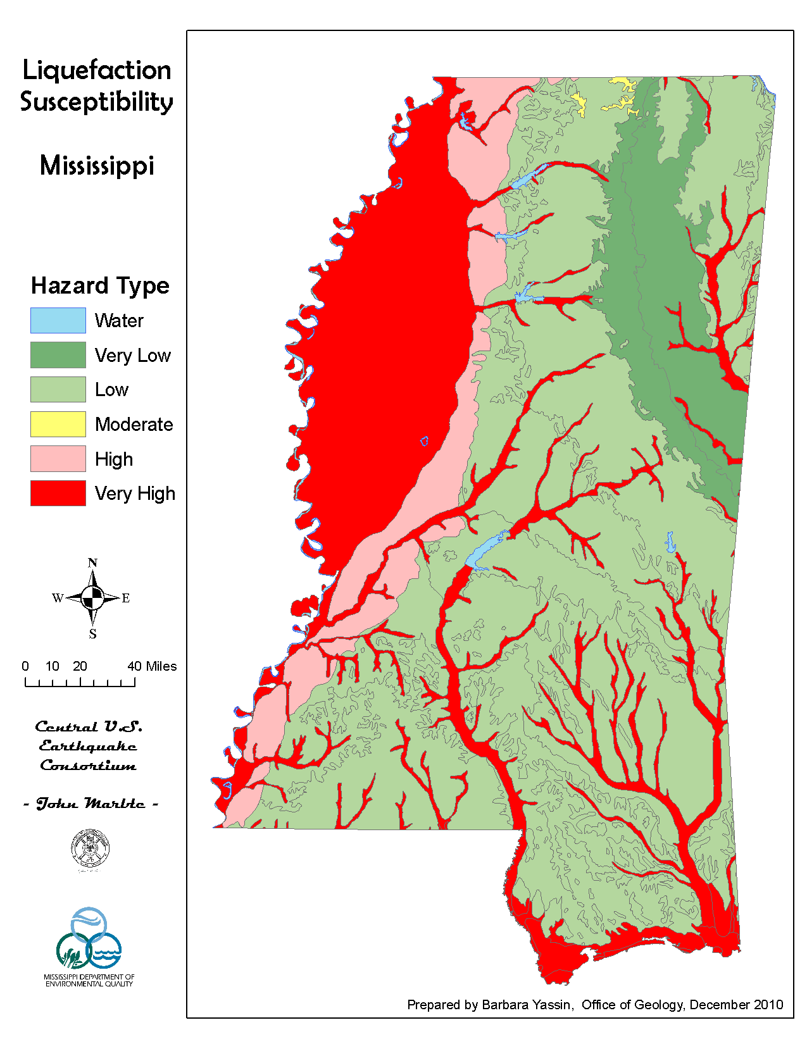

Slide 16
What if it happened today?
40 Million residents
  5M in elementary and secondary school
Business & Industry
  1.8T GDP or 20%
15 Million Buildings
  2M+ FPRs
3K+ Hospital Facilities, 275k Beds
800k Highway Miles
165k Highway Bridges
125k Utility Facilities

Slide 17
What if it happened today?
7.7M New Madrid Earthquake
8 State Perspective
  7+ Million People
  85,000 Injured
  3,500 Deaths
  2M Seek Shelter
  3600 Bridges Damaged
  700K Buildings Damaged
  32K Buildings Collapsed
  $300B Event
  2.6M Households without electricity
  1.1M without Water
  1,500 USAR Teams needed – 28 currently
  Dam and Levee failures
  What about cascading events?
Katrina: $88B / 2500 Deaths / Costliest Hurricane Ever…

Slide 18
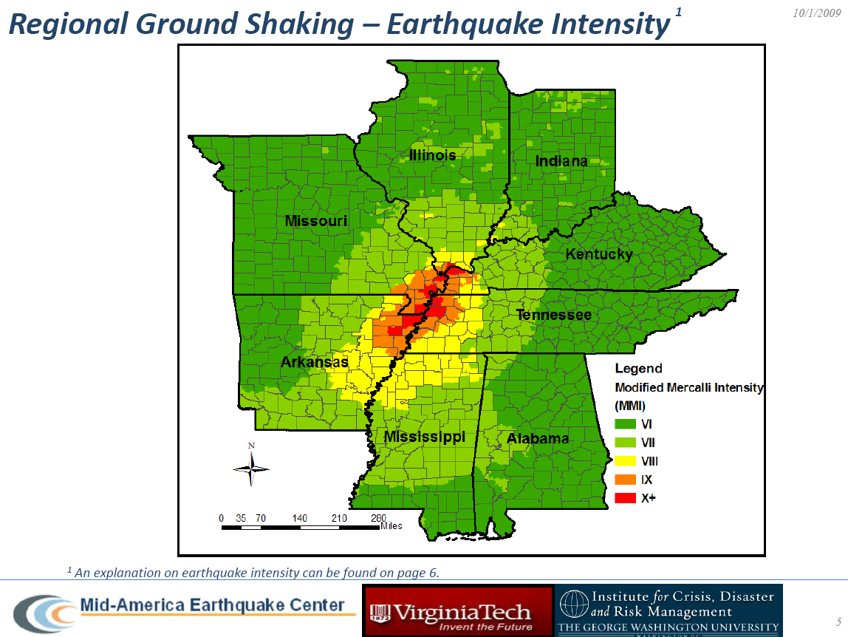

Slide 19
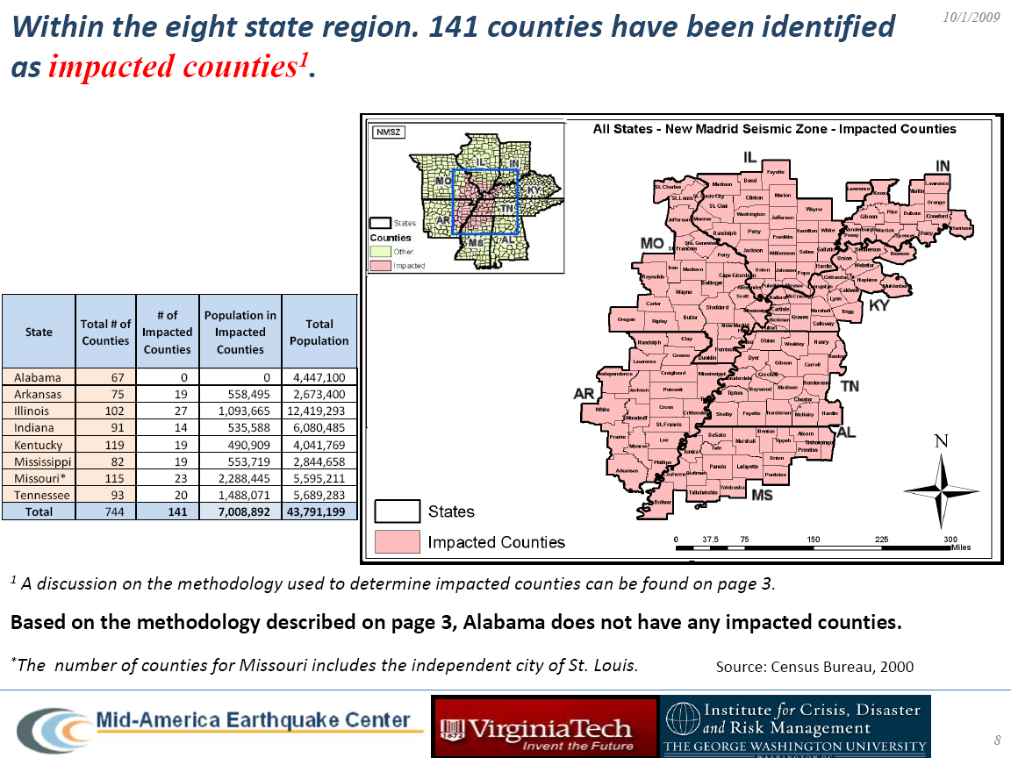

Slide 20
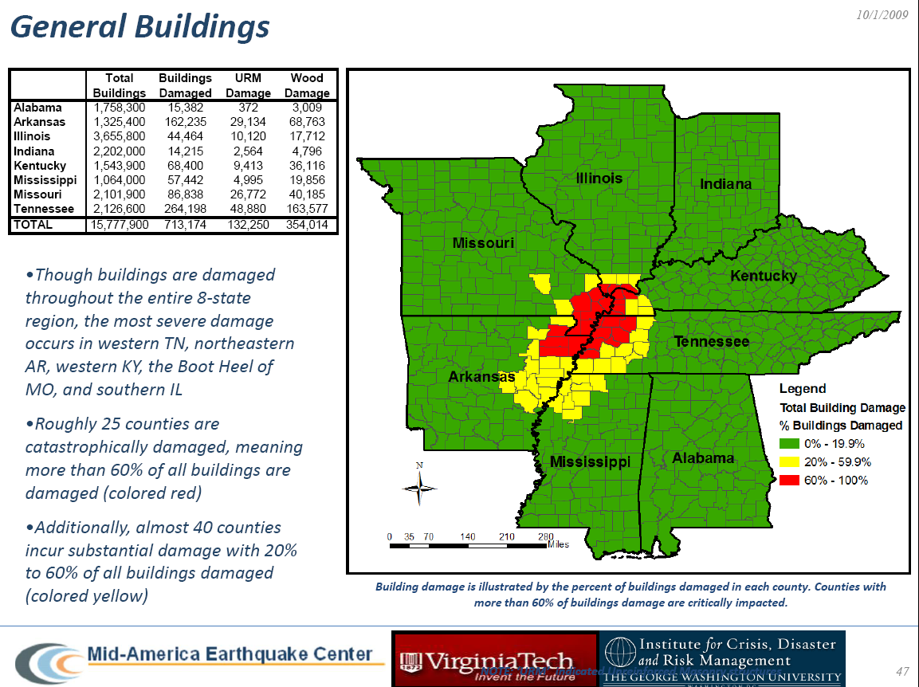

Slide 21
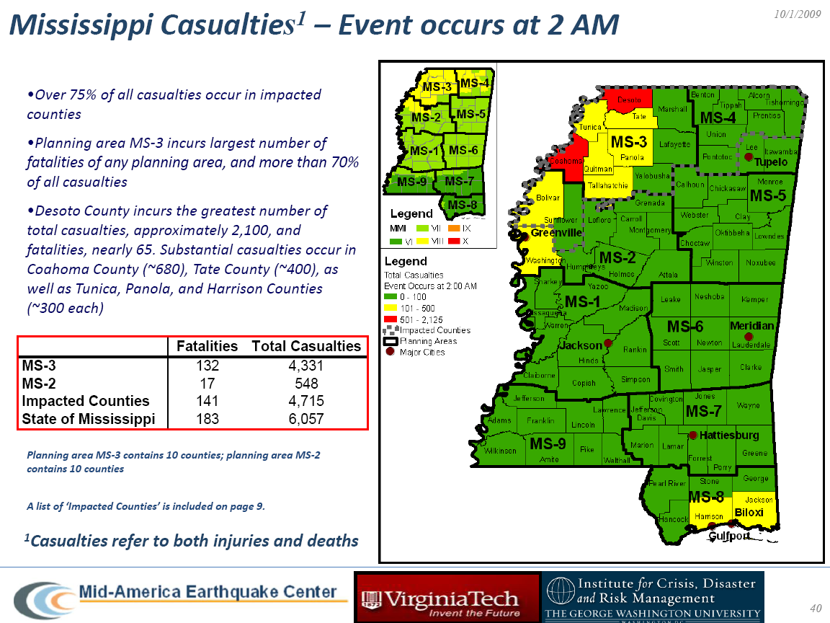

Slide 22
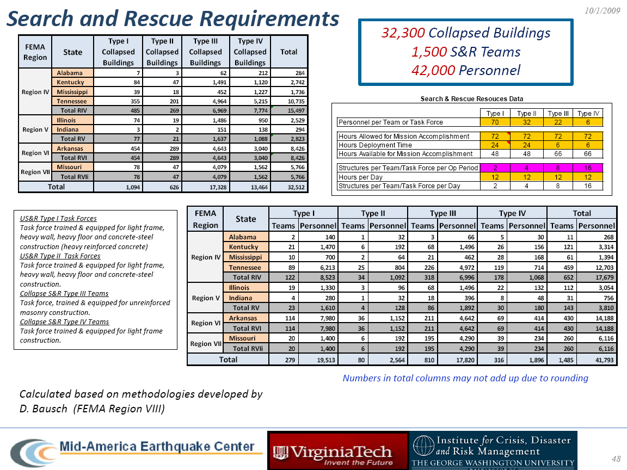
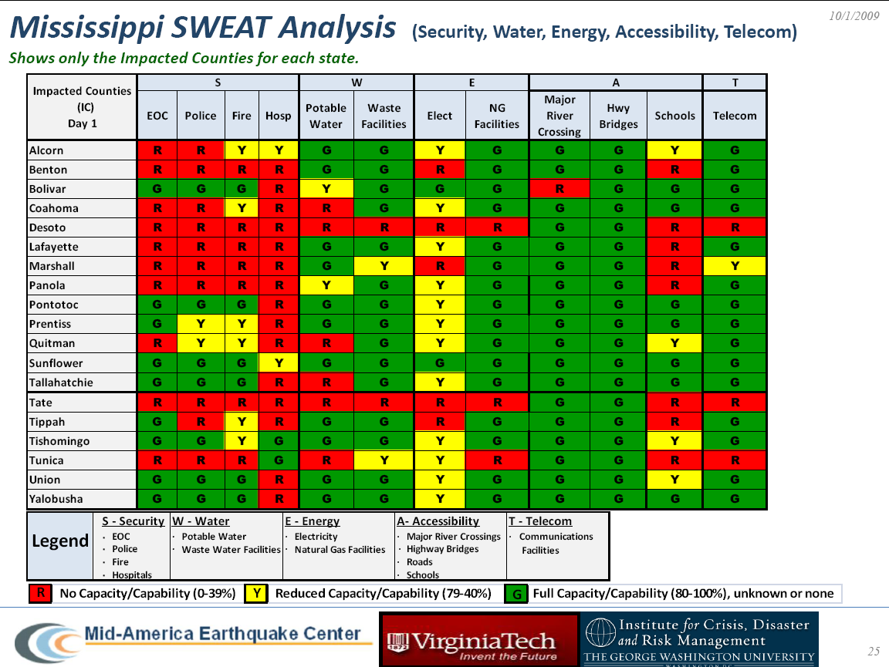

Slide 23
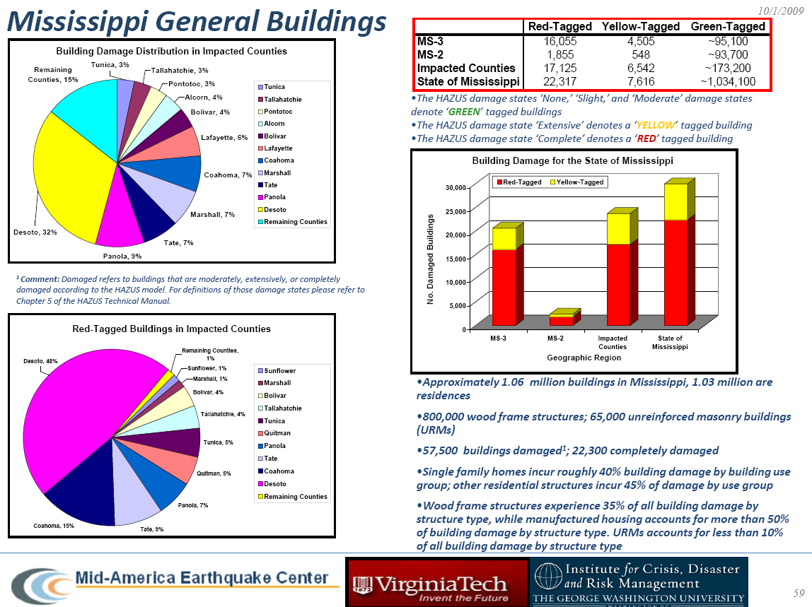

Slide 24
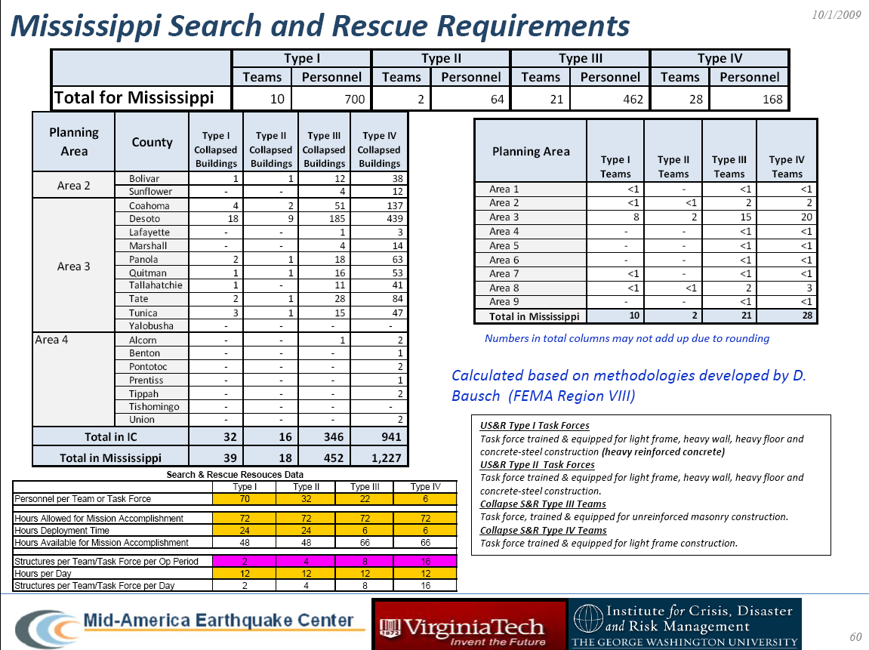

Slide 25
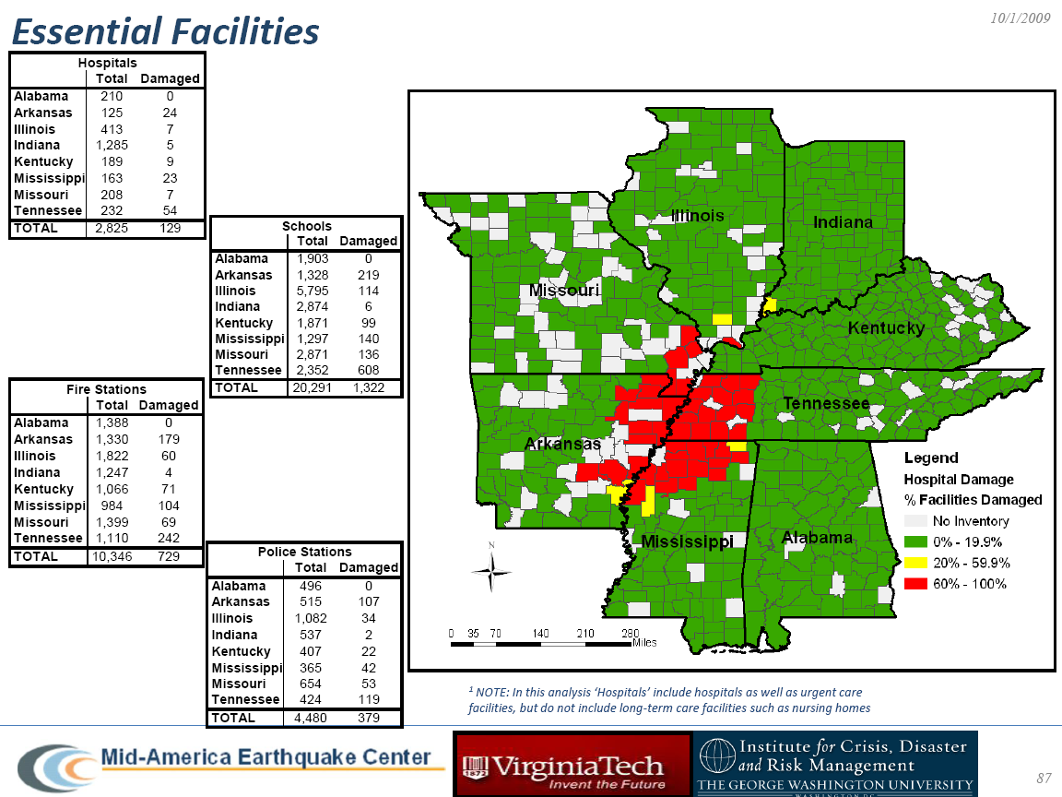

Slide 26
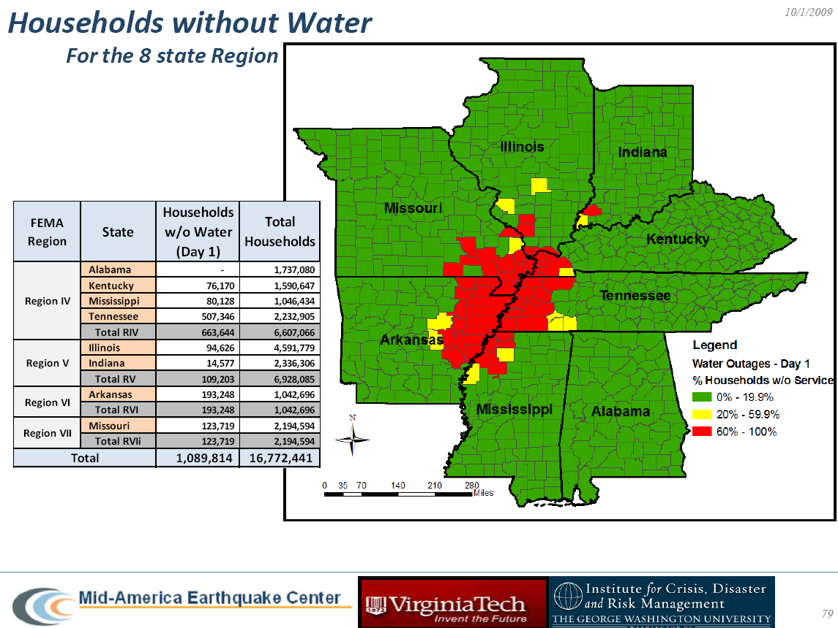

Slide 27
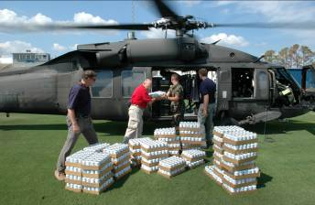
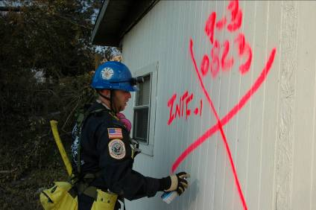
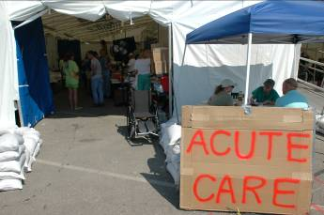
What if it happened here today?
Disaster Response
Food & Water Distribution
Search & Rescue
Photos Courtesy Mississippi Emergency Management Agency
Emergency Health Care

Slide 28

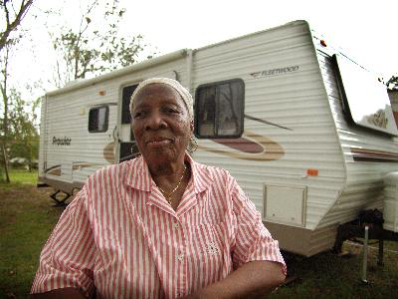
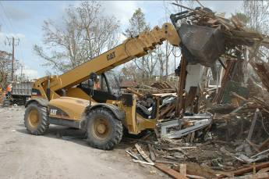
What if it happened here today?
Disaster Recovery
Mass Care
Temporary Housing
Photos Courtesy Mississippi Emergency Management Agency
Debris Removal

Slide 29
The stage is set…
Last significant earthquake in 1895
High percentage of structures built with no seismic considerations
Low level of understanding / belief

Slide 30
What is the risk in Mississippi?
NW Portion of State is most vulnerable, depending on the epicenter of the quake
Lots of Delta “Gumbo”
Secondary Effects
  Liquefaction
  Fire following
  Critical Infrastructure

