Slide 1
Public Assistance Applicant Briefing FEMA-4470 Declared Dec 6, 2019
PREPARING FOR TOMORROW’S DISASTERS TODAY

Slide 2
Clayton French State Public Assistance Officer
Public Assistance Definition
Applicant
Facility
Work
Cost

Slide 3
Public Assistance Defined
Supplemental financial assistance to State and local governments and certain private non-profit organizations for response and recovery activities required as a result of a federally declared disaster.
Funding is cost shared at a federal share of no less than 75% of eligible costs.

Slide 4
Public Assistance Applied
The Public Assistance Program assists in the restoration of community infrastructure.
It is a supplemental cost REIMBURSEMENT program with specific eligibility requirements.
The FEMA share of eligible costs will be awarded to the recipient (grantee) for disbursement to the applicants.

Slide 5
Public Assistance Applied
Public Assistance is NOT –
Assistance to local populations for damages to private houses, commercial property, local businesses, etc.

Slide 6
Partnership
FEMA – manages the program, provides technical assistance, approves grants.
State (Recipient) – educates applicants, works with FEMA to manage the program, implements and monitors grants awarded.
Applicant (Subrecipient) – identifies damage, provides documentation, manages funded projects.

Slide 7
Eligibility Pyramid
COST
WORK
FACILITY
APPLICANT

Slide 8
Eligible Applicants
State
Declared Counties
City / Town / Village within Declared Counties
Other political subdivision of the State
Native American Tribal Governments and Tribal Organizations
Certain Private Non-Profit Organizations

Slide 9
Private Non- Profit Entities (PNP)
To be an eligible PNP Applicant, the PNP must show that is has:
A current ruling letter from the IRS granting tax exemption under 501(c/d/e) or Internal Revenue Code of 1954 or
Documentation from MS Secretary of State substantiating it is a non-revenue producing non profit entity doing business under the State Law.

Slide 10
Private Non- Profit Entities (PNP)
Two categories of PNP
Critical Services
Eligible for both Emergency Work and Permanent Work:
Fire / Emergency Rescue
Medical Treatment
Power, Water, & Sewer Utilities
Communications Systems
Educational Facilities

Slide 11
Private Non- Profit Entities (PNP)
Two categories of PNP
Non-Critical/Essential Services
Eligible for Emergency Work :
Museums, Community Centers, Libraries, Homeless Shelters, Senior Citizens Centers, Zoos, Day-Care Centers, etc.
Non-critical/Essential PNPs must first apply to the Small Business Administration (SBA) for a disaster loan for permanent repair work before applying to FEMA.

Slide 12
Facility Eligibility
To be eligible, the facility must:
Be damaged as a Result of the Declared Event.
Located Within the Presidentially Declared Area.
Be the Legal Responsibility of an eligible Applicant.
Not be under the Authority of a Federal Agency.

Slide 13
Types of Work
Emergency Work
Debris Removal
Emergency Protective Measures
Permanent Work
Roads and Bridge Systems
Water Control Facilities
Public Buildings / Equipment
Public Utilities
Other (Parks, Recreation, etc.)

Slide 14
Emergency Work Categories A & B
FEMA is authorized to provide Public Assistance funding for Emergency Work, including emergency protective measures and debris removal.
Emergency Work is that which must be done immediately to:
Save lives
Protect public health and safety
Protect improved property
Eliminate or lessen an immediate threat of additional damage.

Slide 15
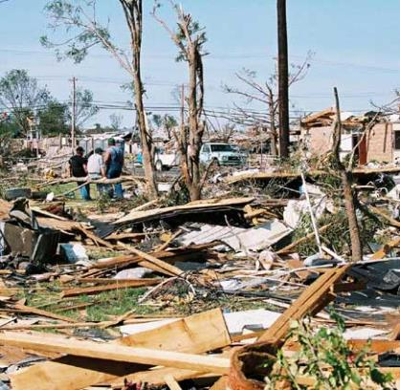
Emergency Work Category A - Debris
Debris removal is eligible when:
It eliminates an immediate threat to life, health, and safety
It eliminates an immediate threat of significant damage to improved property
It ensures economic recovery of the community and provides a benefit for the community-at-large

Slide 16
Emergency Work Category A - Debris
Do’s –
Contact MDEQ for Staging Sites
Truck Certifications
Monitor Debris
Activate your prepositioned Contractor
Bid out debris work beyond 30 days from storm

Slide 17
Emergency Work Category A - Debris
Don’ts –
Stage your debris where ever you want.
Place debris in unpermitted sites.
Continue with Prepositioned Contractor beyond 30 days.
Ignore debris monitoring.

Slide 18
Emergency Work Category B – EPM
Actions taken by applicants before, during, and after a disaster to save lives, protect public health and safety, and prevent damage to improved property. Includes:
Search and Rescue; Fire and Flood Fighting
Security, such as barricades, fencing, or law enforcement.
Push of Debris (not disposal)

Slide 19
Permanent Work Categories C-G
Eligible Permanent Work:
Must repair, restore or replace disaster-damaged facilities in accordance with regulations
Must restore to pre-disaster design, capacity and function in accordance with applicable codes and standards
Must be required as a result of the disaster
May include cost effective hazard mitigation measures

Slide 20
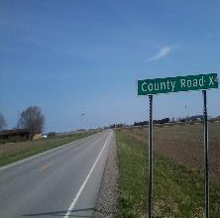
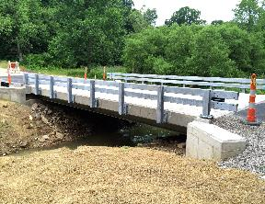
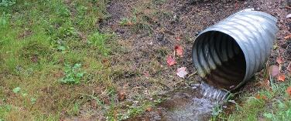
Permanent Work Category C Roads and Bridges
ROADS
Road
Surface
Bases
Shoulders
Ditches
BRIDGES
Decking
Abutments
Wing Walls
Approaches
DRAINAGE STRUCTURES
Culverts
Cross Drains

Slide 21
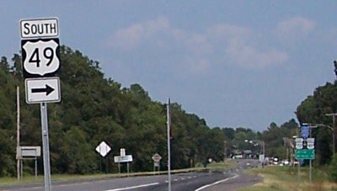
Permanent Work Category C Roads and Bridges
Remember
Public Assistance cannot reimburse items that are under the authority of another Federal Agency.
Many road in Mississippi are Federal Aid roads – making them ineligible for Public Assistance reimbursement.

Slide 22
Permanent Work Category D Water Facilities
Facilities built for the following purposes:
Pumping
Drainage
Irrigation

Slide 23
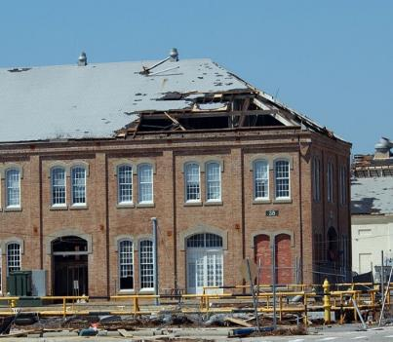
Permanent Work Category E Buildings/Equipment
Buildings/Contents
50% Rule
Codes/Standard
Equipment
Vehicles
Supplies
DEDUCT INSURANCE AND SALVAGE

Slide 24
Permanent Work Category F Utilities
Utilities Include:
Power Generation & Distribution Centers
Water and Sewer Treatment plants
Telecommunication systems
Damage must be disaster-related.

Slide 25
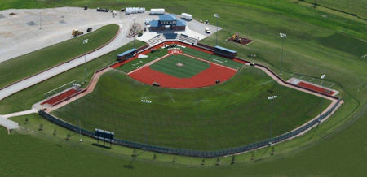
Permanent Work Category G Parks/Recreation
Playgrounds
Swimming Pools
Ballparks
Piers
Beaches

Slide 26
Cost Eligibility
To be eligible for reimbursement, costs must:
Be reasonable and necessary to accomplish eligible work
A cost is reasonable if, in its nature and amount, it does not exceed that which would be incurred by a prudent person under the circumstances prevailing at the time the Applicant makes the decision to incur the cost

Slide 27
Cost Eligibility
To be eligible for reimbursement, costs must:
Comply with federal, state, and local laws and regulations.
Authorized and not prohibited under Federal, State, Territorial, Tribal, or local government laws or regulations.
Consistent with the Applicant’s internal policies, regulations, and procedures that apply uniformly to both Federal awards and other activities of the Applicant.

Slide 28
Cost Eligibility
To be eligible for reimbursement, costs must:
Include deductions of insurance proceeds, salvage value, and purchase discounts.

Slide 29
Eligible Cost
Force Account “LABOR”
Category A – Debris Removal/Clearance – Regular/Straight Time and Overtime (including Fringe Benefits) are eligible (new Sandy Recovery Improvement Act of 2013).
Category B – Emergency Protective Measures – Only Overtime is eligible (including Fringe Benefits).
Category C-G – Regular/Straight Time and Overtime (including Fringe Benefits) are eligible.

Slide 30
Eligible Cost
Materials – The costs for items used from applicant’s inventory and for items purchased to make authorized repairs to meet the scope of work are eligible.
Applicant owned Equipment – The costs associated with the equipment used to perform authorized repairs, all operating equipment hours are eligible, should be supported by Labor Time Sheets. Rates based on FEMA Schedule of Equipment Rates.

Slide 31
Types of Projects
Small Projects
Large Projects
Improved Projects
Alternate Projects

Slide 32
Thresholds
Public Assistance projects are processed as either small or large projects. If the project cost is less than the annually updated cost threshold amount (currently $131,100) the project is processed as a small project. If the project cost equals or exceeds the threshold the project is processed as a large project.

Slide 33
Types of Projects
Small Projects
Funding is based on work completed (if available) or initial cost estimate.
Federal cost share is paid upon project approval.
When the cost of work is less than $3,300, that work is not eligible.
Large Projects
Initially approved based on estimated costs.
Funding is based on documented actual costs.
Federal cost share is paid as work is accomplished.

Slide 34
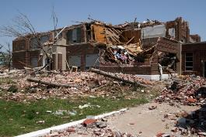
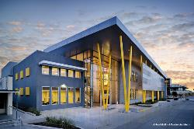
Improved Projects
Applicants performing restoration work on a damaged facility may use the opportunity to make improvements to the facility while restoring the facility to its pre-disaster function.
The improvements must be approved by the State prior to construction.
May require a FEMA Environmental and Historical Assessment.
The applicant is responsible for the cost of the improvements. Federal funding is limited to the cost of restoration.
Before
After

Slide 35
Alternate Projects
When restoration of a damaged facility or function does not serve the public welfare, an applicant may use a Public Assistance grant for another public facility.
The alternate project must be approved by FEMA prior to construction.
A request for the Alternate Project must be made within 12 months of the Scoping Meeting.

Slide 36
Alternate Projects
The alternate project may require an environmental assessment.
Federal funding is limited to 90% of the federal share of the original project estimate or actual Alternate Project costs (whichever is less) for State and local governments, or 75% for PNP applicants.

Slide 37
Project Period of Performance
Time limits for project completion begin on the disaster declaration date.
Emergency work must be completed within 6 months
Permanent work must be completed within 18 months

Slide 38
Project Period of Performance
The Recipient can grant time extension for extenuating circumstances. Those extensions are:
Emergency work: up to 6 additional months
Permanent work: up to 30 additional months
The Regional Administrator may increase these time extensions on a case-by-case basis.
NOTE: If the deadline for any project has been reached, without an approved time extension, no costs past the deadline date will be eligible for funding!

Slide 39
Special Considerations
Special considerations are issues other than program eligibility that could affect the scope of work and funding of a project. These issues include:
Insurance
Hazard Mitigation
Environmental Protection
Floodplain Management
Historic Preservation and Cultural Resources

Slide 40
Insurance
Actual or anticipated insurance proceeds will be deducted from the eligible project costs for facilities that are insured.
All applicants are required to obtain and maintain insurance coverage on all insurable facilities as a condition of Public Assistance funding.
For flood damaged facilities located within a Special Flood Hazard Area that are not covered by flood insurance, FEDERAL ASSISTANCE WILL BE REDUCED BY THE MAXIMUM FLOOD INSURANCE PROCEEDS THAT WOULD HAVE BEEN PAYABLE HAD THE FACILITY BEEN INSURED.

Slide 41
406 Hazard Mitigation
Pre-disaster
Disaster damage
406 Mitigation provides additional funds for damaged items.
Section
406
Larger culvert with
concrete wing-walls

Slide 42
Environmental and Historical Preservation (EHP) Compliance
All FEMA funded projects must comply with a variety of EHP Laws, Regulations and Executive Orders
EHP Review is done prior to funding to ensure compliance with applicable Federal laws.
EHP Review is a collaboration between FEMA, the State, applicants, tribal entities, and local organizations
Construction of new facilities, alternate projects, modification, expansion, or mitigation of existing facilities may require more extensive EHP review.
FEMA must complete review before work starts.

Slide 43
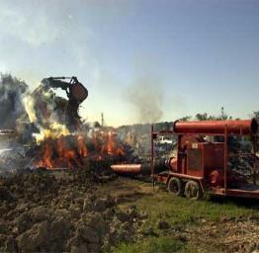
Environmental Protection
To ensure that all practical means are used to protect, restore, and enhance the environment, FEMA projects must comply with all applicable laws and regulations, including
National Environmental Policy Act (NEPA)
Magnuson Stevens Act
Endangered Species Act (ESA)
Clean Water Act (CWA)
Clean Air Act (CAA)
44CFR Parts 9 and 10

Slide 44
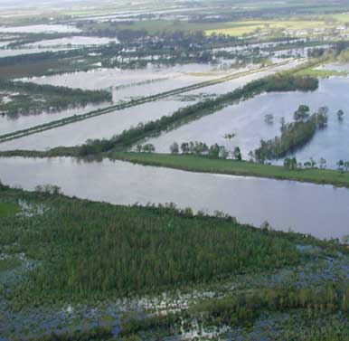
Floodplain and Wetland Management
Any project within or affecting the floodplain or wetlands must be reviewed to ensure that it meets the requirements of several Federal laws and Executive Orders (EO).
EO 11988 Floodplain Management
EO 11990 Protection of Wetlands
Clean Water Act (CWA)

Slide 45
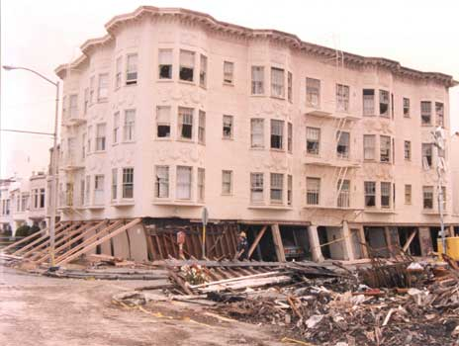
Historic Preservation and Cultural Resources
The National Historic Preservation Act (NHPA) requires FEMA, grantees, and applicants to assess potential effects to historic and cultural resources, such as:
Historical buildings, structures, and districts
Archaeological and tribal sites
Objects and artifacts

Slide 46
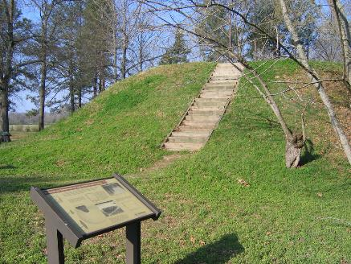
Historic Preservation and Cultural Resources
FEMA, the state, and the applicant work together to identify and address historic preservation issues before approval of funding for a Public Assistance project.
May require consultation with the State Historic Preservation Office (SHPO), Tribal Historic Preservation Officer (THPO), and Advisory Council on Historic Preservation (ACHP).

Slide 47
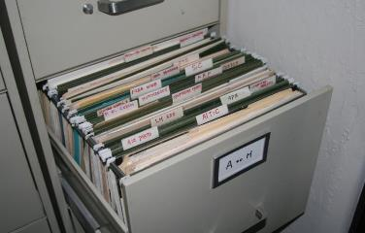
Record Keeping
Applicants are required to maintain complete and accurate documentation, by project, for all disaster-related costs.
Documentation must be maintained a minimum of three years after applicant close-out.

Slide 48
Documentation
Force Account Labor
Force Account Equipment
Material
Rented
Contract

Slide 49
Force Account Labor
Force Account Labor
Applicant’s Payroll Policy (prior to disaster)
Applicant’s Benefits Calculation Worksheet
Applicant’s Complete Employee List
Should include Employee rate
Exempt vs. Non-Exempt Employees
Time Sheets and Payroll Records
Copies of Cancelled Checks / Proof of Direct Deposit

Slide 50
Force Account Equipment
Force Account Equipment
Applicant’s Equipment Listing
Equipment documentation sheets
Employee timesheets reflecting equipment operated time, date of use etc.
FEMA Schedule of Equipment Rates

Slide 51
Force Account Materials
Force Account Materials
Material Summary Record
Applicant’s Materials Inventory List dated prior to disaster (i.e. Assets Inventory)
Materials Requisition Sheets – if available
Invoices for materials purchased and put in inventory and copies of checks paying the invoices.

Slide 52
Procurement
Procurement
Federal, State , Local Requirement, whichever is the most stringent
Training available. Web Search –
“Procurement Disaster Assistance Team”
or https://www.fema.gov/procurement-disaster-assistance-team
and click “Procurement Under Grants 2.0 Webinar Series

Slide 53
Rental Equipment
Rented Equipment
Copies of the signed Rental Agreement(s)
Invoices
Verify proof of payment

Slide 54
Appeals
Any determination related to Federal Assistance may be appealed.
The appeal must be submitted in writing to the State (Grantee) within 60 days of receipt of notice of the action being appealed.
State has 60 days from receipt of appeal letter to
forward it to FEMA.
FEMA has 90 days to render a decision.
Two levels of appeal are available:
to the Regional Administrator and
to the Assistant Administrator for Disaster Assistance Directorate.

Slide 55
Time Limits
Applying for a Public Assistance Grant
Applicant must submit a Request for Public Assistance (RPA) within 30 days of the respective area being designated in the declaration.
Applicant must submit all damages within 60 days from the RECOVERY SCOPING MEETING (formerly called the kick-off meeting).

Slide 56
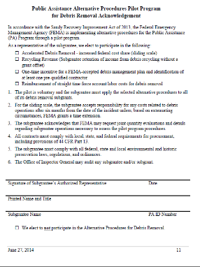
Sandy Recovery Act Changes
Debris Removal Operations
Straight time F/A Labor eligible.
Applicant can retain earnings from recycling.

Slide 57
Sandy Recovery Act Changes
Permanent Work - 428
Grants Based on Estimates (Capped)
Cost overrun absorbed by applicant
Under run can be used by applicant for specific mitigation uses (must be approved by FEMA)
Applicant may consolidate multiple projects in one Project Worksheet
FEMA may accept applicant’s licensed engineer’s cost estimates
Must be very sure of costs
Over runs in permanent work is common

Slide 58
Grants Portal
Public Assistance Grant now utilizes the Grants Portal for application, documentation and project development.
Applicants will trained on the use of the Grants Portal by FEMA.

Slide 59
How to submit RPA
To submit your “Request for Public Assistance” through your Grants Portal Account, simply -
Log In
Click Submit Request for Public Assistance
Follow the prompts
If you don’t have an account, follow the prompts on the next page.

Slide 60
How to submit RPA
Steps:
Go to MississippiPA.org
Click on MEMA Forms
Select Request for Public Assistance

Slide 61
How to submit RPA
MississippiPA.org
Fill out the Request for Public Assistance and send to
recovery1@mema.ms.gov
Please include the EIN/Tax ID Number

Slide 62
Next Steps
Phase I – Operational Planning (continued)
FEMA Assigns PDMG
(Program Delivery Manager)
PDMG Completes Exploratory Call
Applicant Completes Initial Damage Inventory
PDMG Conducts Recovery Scoping Meeting
JFO supervisors establish lean management structure
Exploratory Call
PDMG explains the PA Program
Discusses damages
Introduces Damage Inventory
Discuss documentation
Discuss/schedule Scoping Meeting
Region
JFO/Field
Applicant
CRC

Slide 63
Next Steps
Phase I – Operational Planning (continued)
FEMA Assigns PDMG
(Program Delivery Manager)
PDMG Completes Exploratory Call
Applicant Completes Initial Damage Inventory
PDMG Conducts Recovery Scoping Meeting
JFO supervisors establish lean management structure
Damage Inventory
Applicant captures all disaster related damages
Submitted through Grants Portal
Initial Damage Inventory submitted before Recovery Scoping Meeting
Region
JFO/Field
Applicant
CRC

Slide 64
Next Steps
Phase I – Operational Planning (continued)
FEMA Assigns PDMG
(Program Delivery Manager)
PDMG Completes Exploratory Call
Applicant Completes Initial Damage Inventory
PDMG Conducts Recovery Scoping Meeting
JFO supervisors establish lean management structure
Recovery Scoping Meeting
Damage Inventory discussed
Documentation discussed
Special Considerations discussed
60-day calendar discussed
Site Inspections discussed
Region
JFO/Field
Applicant
CRC

Slide 65
Applicant Agent
Who should be your Applicant Agent?
Understands Program Elements
Familiar with Computer
Well Organized
Readily Available

Slide 66
Observation
The Delivery Model, in effect, will demand more responsibility and work on the Applicant.

Slide 67
Summary
The Public Assistance Program assists in the restoration of community infrastructure.
It is a supplemental cost REIMBURSEMENT program with specific eligibility requirements.

Slide 68
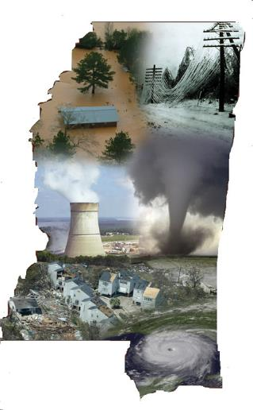
Greg Michel
Executive Director
601-933-6362 or gmichel@mema.ms.gov
Stephen McCraney
Deputy Director
601-933-6635 or smccraney@mema.ms.gov
Todd DeMuth
State Coordinating Officer
601-933-6653 or tdemuth@mema.ms.gov
Clayton French
State Public Assistance Officer
601-933-6886 or cfrench@mema.ms.gov

Slide 69
Public Assistance Applicant Briefing FEMA 4470
PREPARING FOR TOMORROW’S DISASTERS TODAY

