Slide 1
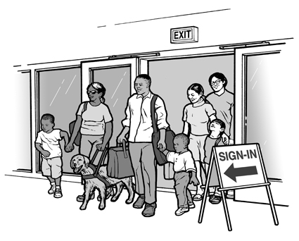
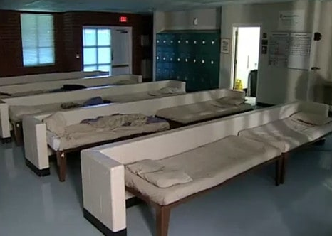
EMERGENCY SHELTERING SUPPORT PLAN

Slide 2
AGENDA
Objectives
Purpose
Concept of Operations
Information Collection, Analysis, and Dissemination
Administration and Finance
Plan Development, Maintenance, Training and Exercises
Authorities and References
Appendices and Attachments

Slide 3
INTRODUCE YOURSELF
Please introduce yourself….
Name
Agency/Position

Slide 4
OBJECTIVES
Upon completion of this course, you will be able to….
Describe county sheltering capabilities.
Understand how shelter responsibilities integrate into NIMS/ICS structure.
Describe procedures for opening, operating and closing shelters.
Describe how support organizations integrate under ESF #6 to manage shelters.

Slide 5
PURPOSE
To support county shelter operations to a response to a major or catastrophic incident.
Notes:
ESF #6 deals with the provision of mass care, emergency assistance and human services support for victims of natural, man-made and technological emergencies and disasters. Sheltering is the immediate housing option following a disaster to ensure a safe and sanitary environment.

Slide 6
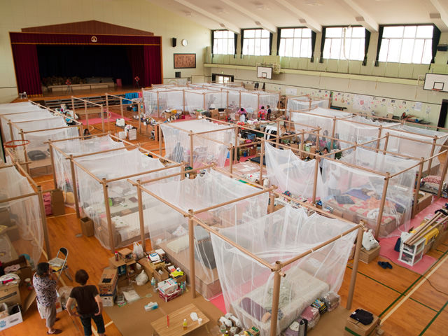
SCOPE
Describe the processes necessary to open, operate, support, and close a county shelter.
Describe the triggers that would necessitate the need for county shelters.
Describe the decision-making process for opening/operating shelters.
Describe the human and material resources needed to support county shelters.
Notes:
[What mechanisms does the county have to update the public on shelter capacity and availability as people and animals are coming to the shelter?] This plan describes the coordination steps and implementation procedures necessary to meet the shelter support requirements within Xxxx County in order to support your county and respond to the needs of the population affected by an incident.

Slide 7
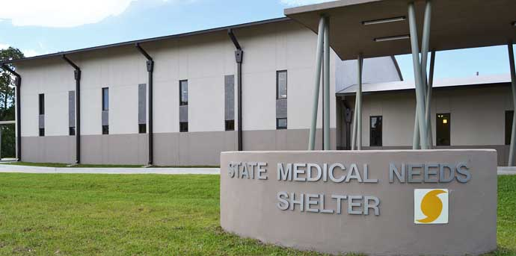
STATE MEDICAL NEEDS SHELTER (SMNS)
Only 1 SMNS in the State (Stone County):
Maximum Capacity is 50 residents.
Residents must be considered medically fragile.
Mission Assignments made through ESF #6 to ESF #8.
* If the State Medical Shelter is at capacity, it is incumbent upon the county to take responsibility for sheltering the medically fragile.
Notes:
[All counties may not have a STF. However, if applicable see Appendix A].
Medical sheltering is the responsibility of ESF #8. ESF #6 supports as appropriate, if requested by ESF #8.

Slide 8
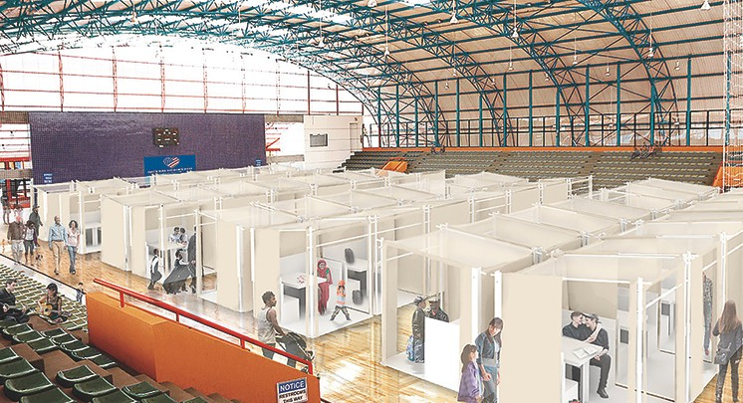
PLANNING ASSUMPTIONS
Public sheltering is a local government responsibility in collaboration with community partners.
School shelters may not be available.
Non-congregate shelters will have to be utilized in order to decrease the spread of COVID-19.
Participating organizations will develop internal procedures and train personnel.
Most people who will require sheltering will not arrive at the shelter with a 72-hour supply of essential life-sustaining items.
Notes:
Next slide lists assumptions but relevant assumptions according to each county should be made based on a county by county bases. *(This section identifies what the county assumes to be facts for planning purposes in order to make it possible to execute the sheltering plan. Please add any additional assumptions that are general or county specific. For example, Claiborne County should add some assumptions about the Grand Gulf Nuclear Station.)

Slide 9
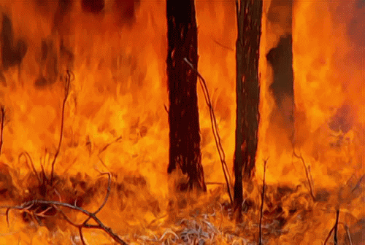
UNDERSTANDING THE SITUATION
When determining the need for opening/operating a shelter, here are some questions for consideration….
What type(s) of incidents would trigger your county to open a shelter?
What type(s) of shelters can you open/operate within your counties?
Target Populations
Access/Functional Needs shelters
How many shelters can you operate with your county resources?
What resources would be required to open/operate a shelter in your county?
Notes:
[What mechanisms does the county have to update the public on shelter capacity and availability as people and animals are coming to the shelter?] This section should provide a process, implemented at the beginning of any potential sheltering event to determine the scope of the sheltering need.

Slide 10
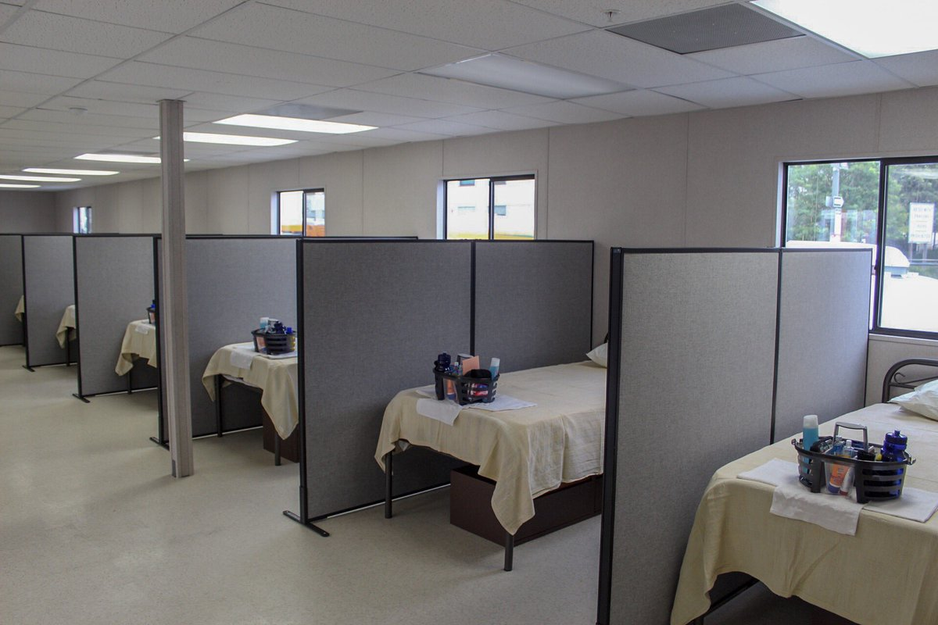
REASONS IN WHICH TO OPEN A SHELTER
There are 3 conditions that would necessitate the opening of a shelter:
Mandatory evacuations
Widespread power outages
Extended displacement from residence
Notes:
[Provide examples of situations in the county when a shelter had to be opened. Additionally, if they are able, counties should separately house individuals who have contracted or have been exposed to COVID. Please insert your county’s non-congregate plan here.] See Appendix

Slide 11
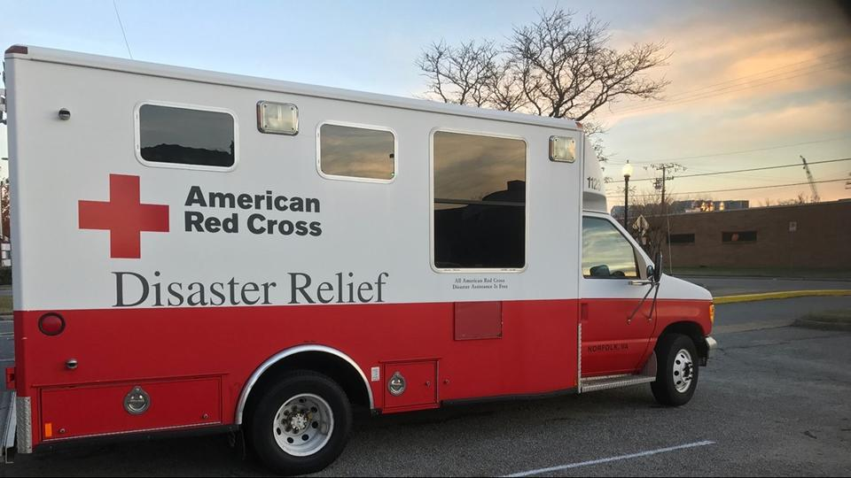
CONCEPT OF OPERATIONS
All incidents begin and end locally!!!!
List the primary organization in your county responsible for sheltering survivors.
List other organizations that will assist in the opening/operation/closing of shelters within your county.
What role does the American Red Cross (ARC) play in your county sheltering plan?
Is there a timeline for notification?
Are shelter staff/volunteers certified?
Are there any MOUs with facility owners?
List sheltering planning/operation into county CEMP.
Include State notification via WebEOC.
Notes:
Reiterate that cooperation between partnering agencies is important even in the initial phase of planning.
Volunteers need to have American Red Cross certifications because of liability purposes and be flexible to in time of need.

Slide 12
COUNTY RESPONSIBILITIES
Designate Shelter Coordinator(s).
Develop a Memorandum of Understanding with the ARC.
Identify county designated shelter facilities.
Train staff to operate disaster shelters.
Provide care and shelter services.

Slide 13
SUPPORT ORGANIZATIONS
The ARC:
Provides care and shelter services
Provides no-cost shelter training
Meets regularly with county representatives to engage in cooperative care and shelter planning
Salvation Army:
Provides food and hydration services (including mobile kitchen units)
Provides clothing distribution
Assists in home clean up (for seniors and people with disabilities)
Provides mental health counseling

Slide 14
HOW LOCAL ORGANIZATIONS CAN HELP
Local Business:
Donate goods/services via pre-disaster agreements
Other Sheltering Support Organizations (i.e. volunteer & community service):
Personnel and equipment
Community and Faith-based organizations:
Feeding, clothing, & essential needs
Trade associations (Real estate, restaurant, grocer, etc.):
Expertise & services
Long-Term Recovery Committee (if applicable):
Return/relocation
Notes:
Other Sheltering Support Organizations - Community and Faith-based organizations (including Community Emergency Response Teams [CERTs], Trade associations (Real estate, restaurant, grocer, etc.)
Long-Term Recovery Committee, if applicable

Slide 15
SHELTER MANAGEMENT AREAS
Operations | Planning | Logistics* | Finance & Admin*
Includes these functions: Registration Food Services Residence Hall First Aid/Medical* Mental Health* Security & Safety* | The Shelter Manager may assume these functions: Maintains liaison w/ EOC Obtains information as needed Anticipates shelter needs and develops action plans to meet needs | Obtains the resources for shelter operations: Personnel Food & Water Supplies & Equipment* Communication* Services for Shelter Residents* | Manages the following: Maintains financial records and documentation of claims, costs and time Processes Purchase orders*
Table 1: Example of Shelter Management Organizational Chart
Notes:
Xxxx County will maintain a roster of employees and volunteers who are trained as shelter workers and will periodically update their contact information. (See Appendix E) The shelter team should consist of persons who can deal sensitively with a diverse shelter population based on the demographics of Xxxx County.
Explain Shelter Management (get county buy-in)
Explain Shelter Registration (get county buy-in)
Explain Feeding Procedures (county should provide this information)
Explain Living Space Requirements (get county buy-in)
Explain Logistics (county should provide this information
Discuss Health Services (county should provide this information)

Slide 16
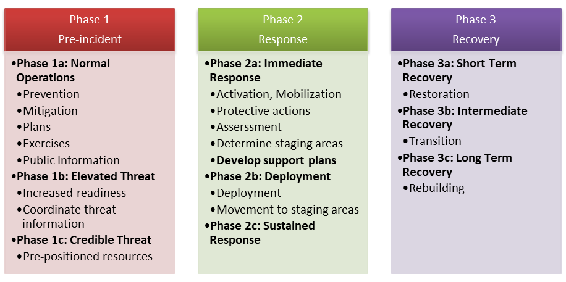
PHASES OF INCIDENT MANAGEMENT
Graphic: Example of Operational Phases
Notes:
Phases are used to group similar activities and aid understanding. The phases of a notice event include actions prior to the incident that increase readiness and available resources in preparation for the event. No-notice events will not include phases 1b and 1c. The sheltering phases are imbedded in the three Operational Phases.

Slide 17
MAKING SHELTER DECISIONS (PRE-INCIDENT)
Determine who identifies the need for a shelter during an incident.
Coordinate the opening of shelters with county Emergency Operations Center (EOC).
When identifying shelters to be opened, consider the following:
Number of shelters needed.
Type(s) of shelters needed.
Locations of each shelter.
*Non-congregate sheltering may be needed if residents test positive for or have been exposed to COVID-19.
Notes:
XXXX County may use a cadre of facilities as shelters. For example, a local church may be converted into a shelter as needed.
Make sure to discuss/define Non-Congregate Sheltering

Slide 18
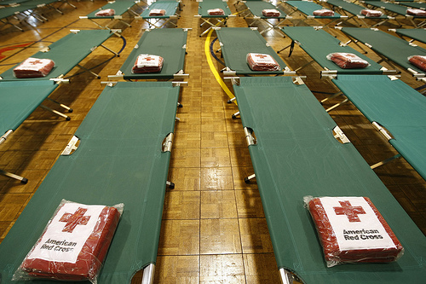
SHELTER OPENING PROCEDURES (WITH ARC ASSISTANCE)
Provide a county staff person to coordinate & assist ARC.
Ensure that all shelter residents complete ALL registration forms (county & ARC).
Coordinate (w/ ARC) the availability of food, supplies, equipment, and services.
Coordinate with law enforcement to ensure shelter security.
Coordinate with county EOC to ensure logistics.
*Shelter is the responsibility of the local government.
**ARC should be notified 72 hours prior to the opening of a shelter (if possible).
Notes:
Local Government Responsibility – Shelter is the responsibility of the local government and this responsibility cannot be delegated. As such, Xxxx County will provide a County staff person to coordinate and assist Red Cross during shelter activation. This County staff person will also ensure that individuals seeking shelter fill out the County Shelter Registration Form as well as the Red Cross Shelter Registration form.
Assist and Provide – the local jurisdiction will assist Red Cross as needed to ensure that adequate food supplies, equipment, staff and services are available to launch and sustain shelter operations. This shall include providing a Xxxx County Sheriff’s deputy for security, as well as coordinating needs and requests with the County EOC Logistics section.
Costs – The Red Cross will pay costs that the Red Cross independently incurs.
American Red Cross should be notified 72 hours prior to opening of a shelter.

Slide 19
SHELTER OPENING PROCEDURES (WITHOUT ARC ASSISTANCE)
Activate county shelter task force.
Deploy staff and support personnel as well as supplies.
Request additional shelter staff as needed:
Possibly from the pool of trained staff.
Mutual Aid Agreements.
Notes:
Activate the Xxxx County Shelter Task Force – Xxxx County will activate their employees and
volunteers who are trained to open and run a shelter.
Deploy – Xxxx County will deploy staff and support personnel, along with startup supplies, to open and
run the shelter.
Additional Personnel – Xxxx County will request additional shelter staff as needed from their trained
pool of employees and volunteers or will request additional staff from the neighboring counties through
Mutual Aid Agreements.

Slide 20
PRIOR TO OPENING A COUNTY SHELTER
Complete a facility use agreement w/ the owner.
Complete inspection of the facility.
Check for existing supplies.
Determine animal services needs.
Determine existing supplies.
Designate shelter positions:
Manager
Registration
Logistics/Feeding
Maintenance/Housekeeping
Establish agreement on COVID-19 cleaning/sanitation requirements.
Set up a waiting area (if needed).

Slide 21
ADDITIONAL SHELTER OPENING PROCEDURES
County shelter checklists should include the following:
Registration:
County documentation
Include signage
ARC documentation (if applicable)
First Aid/Medical Supplies:
First Aid Kits
AED stations
Feeding Capabilities:
Snacks/Meals
Daily Routines:
Maintenance
Cleaning
Notes:
*Counties should develop their own Shelter Opening Checklist
Additional Shelter Opening Procedures include:
Set up Welcome/Registration Desk (“access choke point”).
Ensure proper dormitory space allocation per client (110 sq. ft. / keep 6-foot separation between edges of each cot and arrange cots “head-to-toe”).
Allow families to move their cots closer together.
Establish food distribution and storage areas.
Establish Red Cross office/area.
Establish secure (locked) storage room/area.
Establish Disaster Health Services (DHS) or nurse room/private area.
Ensure method for shelter residents and workers to regularly wash and/or sanitize hands.
Attach refuse bag at end of each cot for clients to have individual waste receptacles.

Slide 22
ADDITIONAL SHELTER OPENING PROCEDURES (CONT.)
Shelter Layout:
Appropriate for target population
Compliant with Americans with Disabilities Act, 1990
Donations and Volunteers
Transportation:
Access to obtain individual goods/services
Pay bills, run errands, etc
Safety / Security:
Local Law Enforcement
Private Security Organizations
Notes:
Additional Considerations for day-to-day shelter operations
Ensure everyone (clients and staff) is screened twice a day and any time they arrive to or re-enter the shelter.
Provide cell phone charging station.
Support virtual service delivery.
Continually promote and enforce physical distancing (6 feet) and handwashing.
Provide communication flow with clients through announcements, reminders, text messages, etc.
Maintain and keep up-to-date shelter and manager logs, screening logs, and sign-in sheets.
Maintain regular sanitation.
Maintain client counts, meal counts, supply inventory, and use counts.
Seek ways to use clients as event-based volunteers (EBVs) and encourage their engagement.

Slide 23
SHELTER OPERATIONS
Shelter operations activities include:
Conduct staff meeting and job inductions.
Conduct screenings for shelter workers and potential residents.
Maintaining daily screening logs for clients, staff, partners, and visitors
Arrange food delivery and other sheltering supplies.
Post signage.
Open shelter.
Advise Emergency Operations Center, public health, local law-enforcement, and disaster relief operation (DRO) on the status of the shelter.

Slide 24
IMPORTANT SHELTER CONSIDERATIONS
Coordination
Which facilities would be best open?
Inspection
Complete pre-occupancy survey with facility owner.
Location
Ensure shelter is in safe, secure areas outside of area of risk.
Verification
Are shelters appropriate for target populations?
Accommodation
Ensure shelter meets all legal requirements (i.e., ADA, Civil Rights, etc.).
Equipment
Does shelter have sufficient human and material resources?
Availability
Are there sufficient support organizations/volunteer organizations?
Notes:
Table 2: Sheltering Considerations (Pre-Incident and Initial Response)

Slide 25
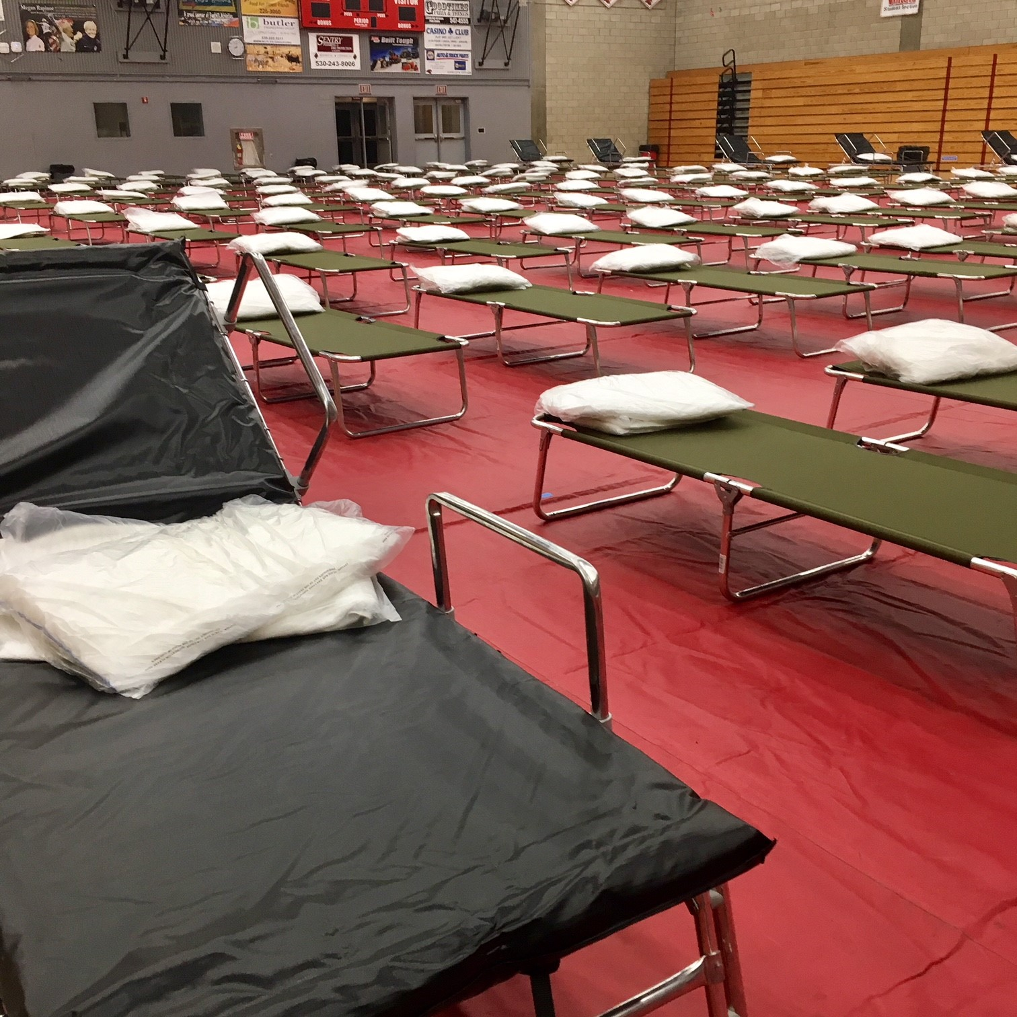
SHELTER CLOSING PROCEDURES
Determine the continued need for shelters.
Based on the incident-specific conditions
Determine official shelter closing date.
Coordinate with EOC/Incident Commander
Coordinate case management
Assist residents with future housing plans.
Ensure accountability.
Equipment/materials accounted for and returned to a state of readiness
Manage additional supplies.
Inventoried and properly stowed
Conduct final inspection.
Building(s)/grounds restored to pre-incident conditions
Conduct walk-thru.
Conducted with facility owner
Secure and manage equipment.
Trailers, dumpsters, forklifts, etc.
Notes:
Upon notification of the de-escalation of an incident, the Xxxx County emergency management agency will work with [add lead sheltering agency] and the STF (Xxxx County Department
of Human Services and American Red Cross) to determine a shelter closing date. Determine how to meet the needs of the remaining shelter residents. Is there a plan for combining multiple shelters to
minimize the number of open shelters? Are there other housing options available? Determine the facility’s availability. Determine the requirements under the sheltering agreement. Determine the
availability of resources.

Slide 26
ADDITIONAL SHELTER CLOSING PROCEDURES
County shelter closing checklists should include the following:
Reunification
Organizations responsible for school children
Procedures for families
Demobilization Triggers
Incident-driven
Shelter population-driven
Status of the area of impact
Electrical power infrastructure
Re-Entry has been authorized
Weather stabilized
Notes:
*Counties should develop their own Shelter Closing Checklist
Stress Reunification process as key component

Slide 27
INFORMATION COLLECTION, ANALYSIS AND DISSEMINATION
Process should be determined by the county CEMP.
Coordinated though the EOC/JIC
ESF #6 Coordinator provides information from shelters to IC/UC.
County External Affairs/PIO
Establish daily briefing/meeting schedules.
Distribute information to the public.
Notes:
[See Xxxx County Comprehensive Emergency Management Plan for coordinated messaging regarding sheltering.] The Xxxx County Comprehensive Emergency Management Plan (CEMP) establishes the daily operational schedule of briefings, meetings and conference calls to ensure a coordinated approach by the agencies in meeting the human and material needs of the incident. In order to obtain and provide relevant and valuable information on a daily basis, the sheltering task force, if activated, will communicate a core set of information to the ESF #6 Coordinator. The ESF #6 Coordinator or designee will detail the type of information they require and frequency of reporting; they will also share relevant information with the sheltering providers to maintain accurate and up-to-date situational awareness.

Slide 28
ADMINISTRATION AND FINANCE
Purchasing and procurement should be approved through county processes.
Determine who is responsible for paying.
Determine who approves payment.
Event costs should be clearly documented and linked to missions and tasks.
Shelter expenditures should be tied to incident for reimbursement.

Slide 29
PLAN DEVELOPMENT AND MAINTENANCE, TRAINING AND EXERCISE
Plan Development and Maintenance
Determine which agency is responsible plan update/revision.
Consider the following:
Meetings with support organizations to gain buy-in
Training of volunteers
Updating community organizations lists
Exercising shelter plans

Slide 30
APPENDICES & ATTACHMENTS
Appendices
Appendix 1: Sheltering Task Force Guidance
Appendix 2: Record of Shelter Training
Appendix 3: Record of Exercises
Appendix 4: Shelter Staff Sign In/Out Form
Appendix 5: Sheltering Staff POC List
Appendix 6: Pandemic Operational Decision Making/Shelter Facility Opening Checklist
Attachments
Shelter layout
Sheltering Checklist(s)
List of County Trained Shelter Personnel

Slide 31
COUNTY SHELTER TASK FORCE (STF)
If you have a Shelter Task Force….
Who are the members who make up your Shelter Task Force?
Have they been trained?
What are their capabilities?
Do they have procedures for managing resources?
Notes:
[All counties may not have a STF. However, if applicable see Appendix A].

Slide 32
SHELTERING TASK FORCE GUIDANCE
Sheltering Task Force Considerations
STF roles.
Job descriptions for key roles
Alert and Notification procedures for STF members
Triggers for constituting an STF
Mobilization and De-mobilization procedures
STF Preparedness and Operational Activities
STF interaction/coordination with other established task forces and the ESF #6 Coordinator
Notes:
It is recommended that the county develops a Sheltering Task Force to help develop, maintain and identify key roles and responsibilities. The guidance in this section is baseline information and the basis for development of Sheltering Task Force guidance that may include

Slide 33
SUGGESTED LIST OF STF MEMBERS
County ESF #6 – Mass Care/Emergency Assistance
County Lead Agency for Sheltering
County Lead or ESF responsible for household pet and service animal support
County Health Care Support
County Department of Children and Family Services
County Volunteer and Donations Coordinator
County Elder Affairs Agency (or agency that provides similar support)
County Agency for People with Disabilities and Others with Access
and Functional Needs
County Evacuation Coordinator
County Security ESF
Planner
Private Sector representative
American Red Cross and The Salvation Army subject matter experts
(SMEs)
VOAD representative
Notes:
Are there other considerations for STF members within your county?
One of the primary responsibilities of the STF is to support and maximize the field resources,
assuring that limited resources are allocated across the jurisdiction, thus minimizing incident
demands for critical or competing resources.
Develop some primary considerations for a task force to consider during the preparedness and operational phases before and during an incident

Slide 34
QUESTIONS

